Slide 1

Embedded Systems Architecture II
Professor: Mike Aleshams
Winter 2021

Slide 2
Course Expectations
You have Ubuntu 16.04LTS/18.04LTS/20.04LTS running on a desktop or laptop machine (“host machine”)
You have a Beaglebone Black or variant (you need access to one at least 3 days per week) – Recommended that you get your own, depending on your group situation (if you meet just once per week, then you should get your own!)
You are willing to purchase some hardware for this class: – A separate touch screen/ or an HDMI cable to use your monitor for the Beaglebone, USB hub, Keyboard and mouse, Ethernet cable, and Power adapter
Familiarity with Git, and have a personal account with github.com:
https://youtu.be/nhNq2kIvi9s

Slide 3
Session – January 21

Slide 4
Module I. Apply advanced services in a multi-tasking OS environment on an embedded target

Slide 5
Introduction
The Beagle platform continues to amaze! Given the proliferation of smart phones, the idea of holding in one hand a computer that is capable of performing two billion instructions per second is easy to take for granted—but the fact that you can modify the hardware and software of such small yet powerful devices and adapt them to suit your own needs and create your own inventions is nothing short of amazing. Even better, you can purchase a board for as little as $25 in the form of a Pocket Beagle.
The Beagle boards on their own are too complex to be used by a general audience; it is the capability of the boards to run Linux that makes the resulting platform accessible, adaptable, and powerful. Together, Linux and embedded systems enable ease of development for devices that can meet future challenges in smart buildings, the Internet of Things (IoT), robotics, smart energy, smart cities, human-computer interaction (HCI), cyber-physical systems, 3D printing, smart manufacturing, interactive art, advanced vehicular systems, and many, many more applications.

Slide 6
Introduction
The integration of high-level Linux software and low-level electronics represents a paradigm shift in embedded systems development. It is revolutionary that you can build a low-level electronics circuit and then install a Linux web server, using only a few short commands, so that the circuit can be controlled over the internet. You can easily use a Beagle board as a general-purpose Linux computer, but it is vastly more challenging and interesting to get underneath the hood and fully interface it to electronic circuits of your own design—and that is where this course comes in!
The Beagle boards are powerful single-board computers (SBCs), and while there are other SBCs available on the market, such as the Raspberry Pi and Intel NUC boards, the Beagle platform has one key differentiator—it was built to be interfaced to! For example, the Beagle board’s microprocessor package even contains two additional on-chip microcontrollers that can be used for real-time interfacing—an area in which other Linux SBCs have significant difficulty.

Slide 7
Introduction
Unlike most other SBCs, the Beagle boards are fully open-source hardware. The BeagleBoard.org Foundation provides source schematics, hardware layout, a full bill of materials, and comprehensive technical reference manuals, enabling you to modify the design of the Beagle platform and integrate it into your own product.
The Beagle Bone and PocketBeagle boards run the Linux operating system, which means you can use many open-source software libraries and applications directly with them. Open-source software driver availability also enables you to interface devices such as USB cameras, keyboards and Wi-Fi adapters with your project, without having to source proprietary alternatives. Therefore, you have access to comprehensive libraries of code that have been built by a talented open-source community; however, it is important to remember that the code typically comes without any type of warranty or guarantee. If there are problems, then you have to rely on the good nature of the community to resolve them. Of course, you could also fix the problems yourself and make the solutions publicly available.

Slide 8
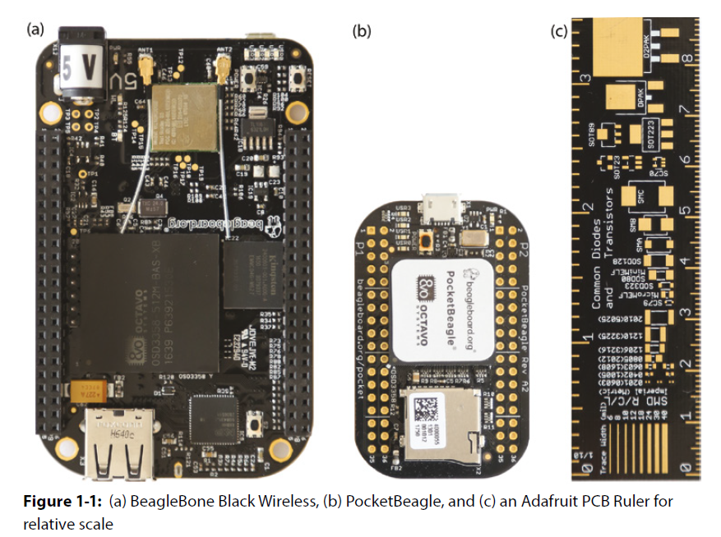
Introduction
The Beagle Bone and PocketBeagle boards are quite different in physical appearance, as displayed in the following Figure, but they are similar devices under the hood. To illustrate this, both boards are typically booted with the same Linux image on a micro-SD card. The Linux image will automatically detect and configure the differing hardware during the boot sequence depending on the board it is booting.

Slide 9
When to Use Beagle Boards
The major advantage over more traditional embedded systems, such as the Arduino, PIC, and AVR microcontrollers, is apparent when you leverage the Linux OS for your projects. For example, if you built a home automation system using the Beagle Bone and you then decided that you wanted to make certain information available on the internet, you could simply install a web server. You could then use server-side scripting or your favorite programming language to interface with your home automation system to capture and share the information.
Alternatively, your project might require secure remote access. In that case, you could install a secure shell (SSH) server simply by using the Linux command sudo apt install sshd. This could potentially save you weeks of development work.
In addition, you have the comfort of knowing that the same software is running securely on millions of machines around the world. Linux also provides you with device driver support for many USB peripherals and adapters, making it possible for you to connect cameras, Wi-Fi adapters, and other low-cost consumer peripherals directly to your platform, without the need for complex and/or expensive software driver development.

Slide 10
When Should You Not Use the Beagle Boards
The Linux OS was not designed for real-time or predictable processing. As a result, there are significant challenges in using this OS for deterministic processing tasks such as sampling a sensor precisely every one-millionth of a second. Therefore, in its default state, the Beagle boards are not an ideal platform for real-time systems applications. Sophisticated real-time versions of Linux are available, but they are currently targeted at experienced Linux developers. However, unlike many other Linux SBCs, the Beagle Bone does have an on-board solution that goes some way toward resolving this interfacing problem. Within the AM335x SoC, there are two on-board microcontrollers, called programmable real-time units (PRUs), which can be programmed for real-time interfacing applications.
The second application type that the Beagle platform will find difficult is that of playing or processing high-definition video. The processing overhead of software decoding and playing encoded video streams is immense and is beyond the capability of the Beagle Bone at high-definition video resolutions. The Raspberry Pi (www.raspberrypi.org) board has this capability because its Broadcom BCM2835/7 processors were designed for multimedia applications, and it has a hardware implementation of H.264/MPG-4 decoders and encoders.

Slide 11
When Should You Not Use the Beagle Boards
If your intention is to develop an embedded Linux image processing or computer vision platform, then you should consider the Xilinx Zynq platform (tiny.cc/beagle102), as it integrates an ARM-based processor that can run Linux alongside the hardware programmability of an FPGA. This allows the computationally intensive but parallelizable image processing functionality to be offloaded from the Linux kernel to the programmable logic hardware. Boards such as the PYNQ, ZYBO, or Arty Z7 are available, but be aware that they are complex devices.
For interfacing Linux to electronic circuits, it is hard to beat the Beagle boards as the range of input/outputs, openness of the platform, and quality of documentation available are second to none.

Slide 12
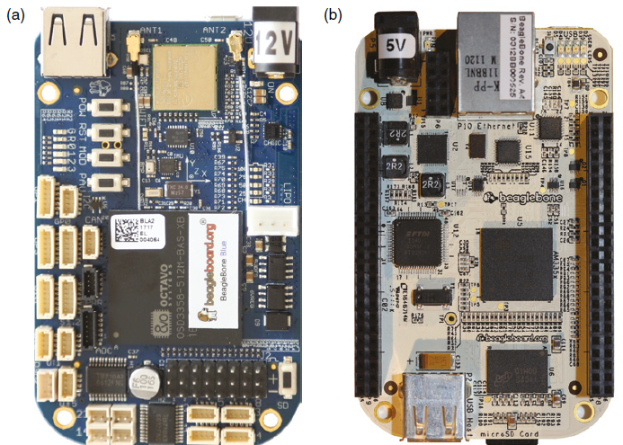
The Beagle Hardware
At its heart, the Beagle boards use the Texas Instruments Sitara AM335x Cortex A8 ARM microprocessor. As previously mentioned, there are several versions of the Beagle Bone available, as illustrated in the following Figure, in particular the older Beagle Bone White, or just Beagle Bone; the Beagle Bone Black (BBB); and the wireless versions. All boards have a small form factor, fitting neatly inside an Altoids mint tin; in fact, the PocketBeagle fits inside a tiny Altoids Smalls tin

Slide 13
The Beagle Hardware
The non-wireless BBB has Ethernet connectivity, which can be particularly useful for applications in which the board acts as a network Bridge Router (e.g., for 6LoWPAN applications).
When wireless networking is required, the BBB Wireless works well in mobile connected embedded applications where video may be required, and the Beaglebone Blue is strong for mobile tasks that interface to motors, for applications such as robotics and automation.
The PocketBeagle is particularly useful when cost, size, and weight are important considerations for a project. Despite having no on-board wireless connectivity, this can be added and customized for a particular project. For example, you might add one of Wi-Fi, Bluetooth, or 802.15.4-based communications to your project by interfacing modules to the boards USB or UART connections. Interestingly, the bottom side of the PocketBeagle has no components, which means that it can be mounted flush to a carrier printed-circuit board (PCB).

Slide 14
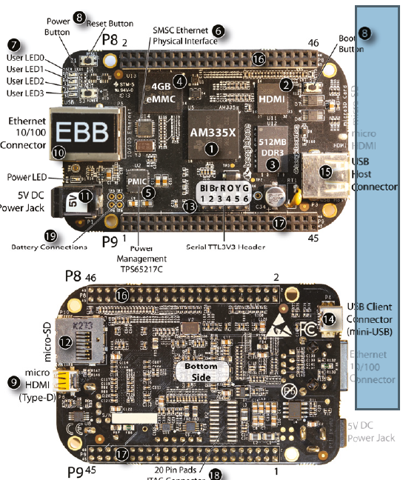
The Beagle Hardware
The following Figure details the core system
of the BBB board. The microprocessor on the
BBB is a Texas Instruments Sitara AM335x
Cortex A8 ARM Microprocessor.2 It is a
reduced instruction set computing (RISC)
processor, so at 1,000 MHz the processor
executes 2,000 million instructions per second
(MIPS). The processor runs at about 1W idle
and 2.3 W for heavy processing loads.

Slide 15
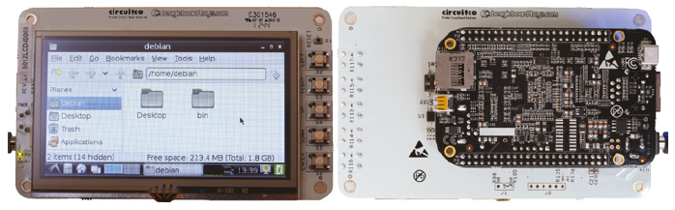
Capes
Capes are daughter boards that can be attached to the P8/P9 expansion headers on the Beagle Bone boards or the P1/P2 expansion headers on the PocketBeagle. These are called capes (as in Superman’s cape) because of the shape of the boards as these wrap around the RJ 45 Ethernet connector on the BBB. You can connect up to four capes at any one time when the capes are compatible with each other. Some capes use a significant number of pins.
For example, you will look at the LCD4 cape in the following Figure. The LCD4 cape uses the P8 header pins 27 through 46 and some of the analog inputs for its buttons and resistive touch interface. If you are using the eMMC for booting the BBB, then few pins remain for GPIO use. In addition, the LCD cape does not carry forward the pin headers.

Slide 16
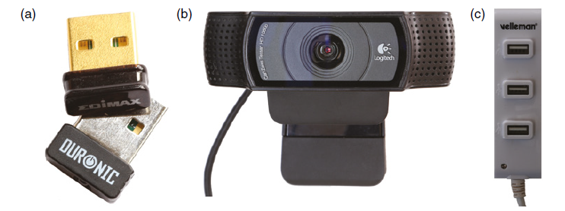
Optional Accessories
The following sections describe optional accessories that you may need, depending on the applications that you are developing (see the following Figure):
USB Hub (to Connect Several USB Devices to a USB Host)
Micro-HDMI to VGA Adapters (for VGA Video and Sound)
Wi-Fi Adapters (for Wireless Networking)
USB Webcam (for Capturing Images and Streaming Video)
USB Keyboard and Mouse (for General-Purpose Computing)

Slide 17
How to Destroy Your Board!
Unlike the Arduino Uno, the microprocessor on the boards cannot be replaced—if you damage the SoC or SiP, you will need to buy a new board! Here are some things that you should never do:
Do not shut the board down by pulling out the power jack/USB power. Correctly shut the board down by using a software shutdown (e.g., by pressing the power button once) or by holding the power button for about eight seconds for a “hard” power down. This enables the power management IC (PMIC) to shut down the board correctly. If you need to remove power by disconnecting the power supply, hold the reset button while doing so to lower system power usage.
Do not place a powered board on metal surfaces (e.g., aluminum-finish computers) or on worktops with stray/cut-off wire segments, resistors, etc. If you short the pins (or the solder points) on the expansion headers, you can easily destroy your board. You can buy a case from suppliers such as Adafruit. Alternatively, you can attach small rubber feet to the board.

Slide 18
How to Destroy Your Board!
Do not connect circuits that source/sink other than very low currents from/to the expansion headers. The maximum current that you can source from many of these header pins is 4-6 mA and the maximum current you can sink is 8 mA. The power rail and ground pins can source and sink larger currents. The Arduino allows currents of 40 mA on each input/ output.
The GPIO pins are 3.3 V tolerant (most of the ADCs are 1.8 V tolerant). Do not connect a circuit that is powered at 5 V or you will destroy the board.
Do not connect circuits that apply power to the expansion header while the board is not powered on. Make sure that all self-powered interfacing circuits are gated by the 3.3 V supply line or through the use of optocouplers.

Slide 19
Linux Distributions for Beagle Boards
The word embedded in the term embedded Linux is used to convey the presence of an embedded system whose main part is a hardware platform like a beagle bone. Linux is released under the GNU General Public License (GPL), which grants users the freedom to use and modify its code in any way; so, free generally refers to “freedom” rather than to “without cost.”
The freedom to use the software for any purpose
The freedom to change the software to suit your needs
The freedom to share the software with your friends and neighbors
and, the freedom to share the changes you make
Even if you are using a distribution that you downloaded “for free,” it can cost you significant effort to tailor libraries and device drivers to suit the particular components and modules that you want to use in your product development.
There are many different distributions of Linux for embedded system platforms, including expensive proprietary versions for real-time programming, but the main open-source distributions used by the community on the Beagle boards include Debian, Ångström, Ubuntu, and Arch Linux.

Slide 20
Linux Distributions for Beagle Boards
Don’t be too worried that you might damage the Linux file system when you are practicing with the Beagle boards. In the worst case, you might have to write a new Linux image to the micro-SD card or to the eMMC. It takes about 20–45 minutes to write the image to the board.
The easiest way to set up an SD card so that it can be used to boot the PocketBeagle or other Beagle boards is to download a Linux distribution image file (.img file in a compressed .xz wrapper) from beagleboard.org/latest-images and write it to an SD card using an image writer utility such as Etcher (etcher.io). Etcher is particularly useful because it can use the compressed image file directly. The application is available for Windows, Mac, and Linux host machines.
The default login details for Debian are username debian with the password temppwd. Under Ubuntu use ubuntu/temppwd. Ångström and Arch Linux have username root and no password (just press Enter).

Slide 21
Wired Networked Boards
There are three main ways to connect to and communicate with the board over a wired network, each with its own advantages and disadvantages:
The first way is to use internet-over-USB, which creates a “private” virtual LAN using a single USB cable. This approach works for all Beagle boards, but the following approaches require a board that has an Ethernet adapter.
The second way is to use regular Ethernet, and
the third is to use an Ethernet crossover cable.
Several boards have on-board Wi-Fi capabilities, but you may need to connect to the board over an internet-over-USB or serial connection to configure Wi-Fi for connection to your network. The default Wi-Fi address is 192.168.8.1. To modify the configuration files for a Wi-Fi adapter, you can use the USB-to-TTL cable. Alternatively, you could mount the micro-SD card for the target board under a desktop Linux OS (or another booted Beagle Bone) and modify the configuration files directly.

Slide 22
Communicating with the Boards
When you are ready to try your Beagle board, the first thing you should do is connect it to your desktop computer using a USB lead. After you apply power, the board will connect to the desktop in USB client mode. Once it’s connected and discovered, your file manager, such as Windows Explorer, will display the contents of the board’s FAT partition.
With the latest Beagle board Linux images you should no longer have to install drivers for your operating system. Once the board is fully booted, several new devices should be available on your desktop computer. For example, you will now have the following devices (These new devices can be used to connect to the board):
Access to the FAT partition of the board (like a USB memory key).
Serial access to the board using a new Gadget Serial driver COM port.
A Linux USB Ethernet/RNDIS Gadget (for internet-over-USB). RNDIS stands for Remote Network Driver Interface Specification.

Slide 23
Communicating with the Boards
The Gadget Serial device will allow you to connect to the board directly using a Serial connections are particularly useful when the board is close to your desktop computer and connected via the USB cable. It is often a fallback communications method when something goes wrong with the network configuration or software services on the board.
To connect to the board via the serial connection over USB, you need a terminal program. Several third-party applications are available for Windows, such as RealTerm (realterm.sourceforge.io) and PuTTY (www.putty.org). PuTTY is also used in the next section. Most distributions of desktop Linux include a terminal program (try Ctrl+Alt+T or use Alt+F2 and type gnome-terminal under Debian).
A terminal emulator is included by default under macOS (e.g., type screen/dev/tty.usbmodemfa133 115200).

Slide 24
Communicating with the Boards
To connect to the Beagle board over the USB serial connection, you need to know some information:
COM port number: You can find this by opening the Windows Device Manager and searching under the Ports section.
Speed of the connection: By default you need to enter 115,200 baud to connect to the board.
Other information you may need for other terminal applications: Data bits = 8; Stop bits = 1; Parity = none; and, Flow control = XON/XOFF.
Save the configuration with a session name so that it is available each time you want to connect. Click Open, and it is important that you press Enter when the window appears. When connecting to Debian, you should see the following output:
Debian GNU/Linux 9 beaglebone ttyGS0
BeagleBoard.org Debian Image 2018-03-05
Support/FAQ: http://elinux.org/Beagleboard:BeagleBoneBlack_Debian
default username:password is [debian:temppwd]
beaglebone login: debian
Password: temppwd
debian@beaglebone:~$

Slide 25
Communicating with the Boards
This allows you to log in with username debian and password temppwd.
On a Linux desktop computer, you can install the screen program and connect to the serial-over-USB device with these commands:
molloyd@debian:~$ sudo apt-get install screen
molloyd@debian:~$ screen /dev/ttyUSB0/ 115200
Serial
There are other ways to communicate with the board rather than Serial Connection over USB including:
Serial Connection with the USB-to-TTL 3.3 V Cable 43
Connecting Through Secure Shell 44
Secure Shell Connections Using PuTTY 45
Chrome Apps: Secure Shell Client 45
Transferring Files Using PuTTY/psftp over SSH

Slide 26
Controlling the Beagle Board
You are now connected to the board, and the Linux terminal is ready for your command. The $ prompt means you are logged in as a regular user account (super-users have a # prompt). For a new Linux user, this step can be quite daunting, as it is not clear what arsenal of commands is at your disposal. This section provides you with sufficient Linux skills to get by.
The first thing you might do is determine which version of Linux you are running. This can be useful when you are asking a question on a forum.
debian@beaglebone:~$ uname -a
Linux beaglebone 4.9.82-ti-r102 #1 SMP PREEMPT Thu Feb 22 01:16:12 UTC
2018 armv7l GNU/Linux
debian@beaglebone:~$ cat /etc/dogtag
BeagleBoard.org Debian Image 2018-03-05
In this case, Linux 4.9.82 is being used, which was built for the ARMv7 architecture on the date that is listed and packaged for the BeagleBoard.org image on the date that is listed in the “dog tag.”

Slide 27
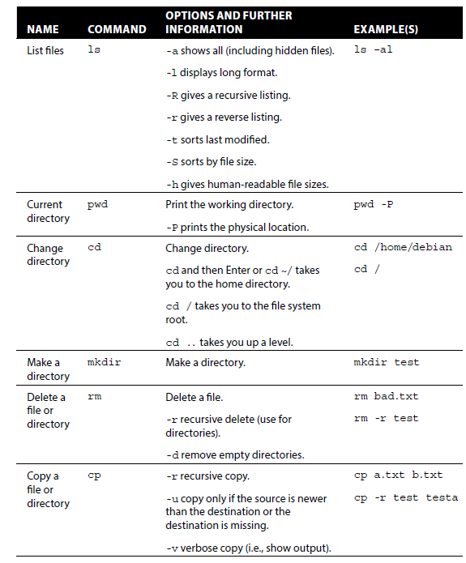
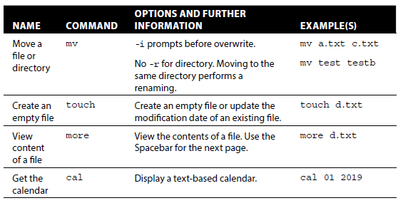
Controlling the Beagle Board
When using Debian and Ubuntu user accounts
you often must prefix the word sudo at the
start of certain commands. That is because
sudo is a program that allows users to run
programs with the security privileges of
the supe-ruser. For the moment, the basic
file system commands that you need are
listed in the following Table.

Slide 28
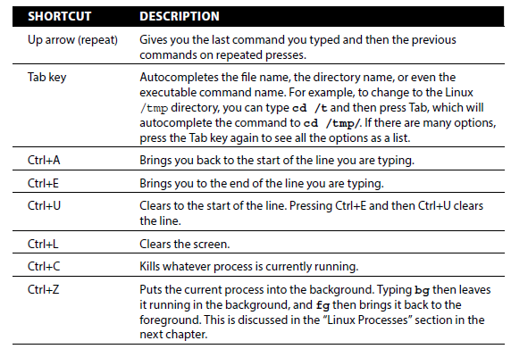
Controlling the Beagle Board
The following Table describes a few shortcuts that make life easier when working with most Linux shells.

Slide 29
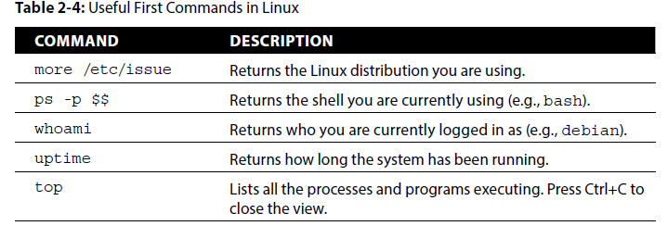
Controlling the Beagle Board
Next, you could use the passwd command to set a non-default debian user account password.
debian@beaglebone:~$ passwd
Changing password for debian.
(current) UNIX password: temppwd
Enter new UNIX password: newpasswd
Retype new UNIX password: newpasswd
passwd: password updated successfully
The following Table lists other useful first-step commands.

Slide 30
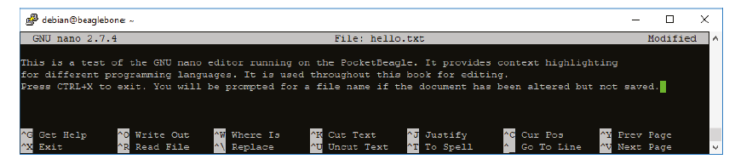
Controlling the Beagle Board
A variety of editors are available, but perhaps one of the easiest to use for new users is also one of the most powerful—the GNU nano editor. You can start up the editor by typing nano followed by the name of an existing or new filename; for example, typing nano hello.txt will display the view captured in the following Figure (after the text has been entered!). Typing nano -c hello.txt will also display line numbers, which is useful when debugging program code. You can move freely around the file in the window using the arrow keys and edit or write text at the cursor location. You can see some of the nano shortcut keys listed on the bottom bar of the editor window.

Slide 31
Assignment 1
A simple question like this causes more difficulty than you can imagine. If you type date at the shell prompt, you may get the following, which is months out-of-date in this case, even where the board is connected to the desktop PC using an internet-over-USB connection.
debian@beaglebone:~$ date
Thu Apr 5 01:06:59 UTC 2018
Why can’t the board display the correct date?
What’s the solution? Demonstrate it!

Slide 32
Session – January 28

Slide 33
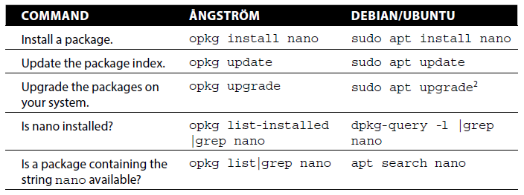
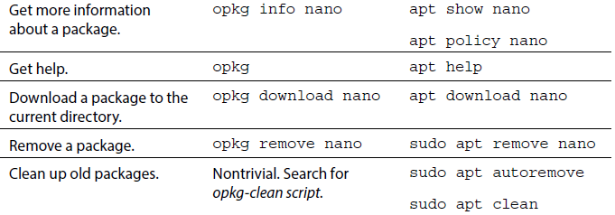
Controlling the Beagle Board
A package manager is a set of software tools that automate the process of installing, configuring, upgrading, and removing software packages from the Linux operating system. Different Linux distributions use different package managers: Ubuntu and Debian use APT (Advanced Packaging Tool) over DPKG (Debian Package Management System). For example, the first row in the following Table lists the command for installing a package using different managers.

Slide 34
Controlling the Beagle Board
You should update the package lists at regular intervals (the sudo password is your Debian account password) using the apt update command. Once this is complete, you can automatically download and install the latest versions of the available software using the apt upgrade command. Clearly, you should always perform an apt update command before an apt upgrade.
There are Beagle-specific tools available for configuring your board that have been developed by the BeagleBoard.org community. These tools simplify some tasks that would otherwise be quite difficult. They are located in the /opt /scripts/tools directory and are described in this section. Before you use the tools, check that you have the latest versions.
debian@beaglebone:~$ cd /opt/scripts/tools/
debian@beaglebone:/opt/scripts/tools$ git pull || true
Already up-to-date.
debian@beaglebone:/opt/scripts/tools$ ls
beaglebone-black-eMMC-flasher.sh grow_partition.sh update_kernel.sh
developers init-eMMC-flasher.sh version.sh
dtc non-mmc-rootfs wm
eMMC readme.txt
graphics software

Slide 35
Controlling the Beagle Board
If you have installed a BeagleBoard.org Linux image on a micro-SD card of greater than 4 GB capacity, then you should expand the file system to use the full card capacity. In this example, a 32 GB micro-SD card is used in a PocketBeagle, and the Debian IoT image size is 4 GB. Using the lsblk tool, you can see that most of the SD card is unavailable for use, with the df tool indicating that the Linux partition is 54 percent full.
debian@beaglebone:~$ lsblk
NAME MAJ:MIN RM SIZE RO TYPE MOUNTPOINT
mmcblk0 179:0 0 29.8G 0 disk
└_mmcblk0p1 179:1 0 3.3G 0 part /
debian@beaglebone:~$ df -k
Filesystem 1K-blocks Used Available Use% Mounted on
udev 219844 0 219844 0% /dev
tmpfs 49624 4972 44652 11% /run
/dev/mmcblk0p1 3357264 1684596 1482412 54% /

Slide 36
Controlling the Beagle Board
You can use the grow partition tool as follows:
debian@beaglebone:/opt/scripts/tools$ sudo ./grow_partition.sh
Media: [/dev/mmcblk0]
sfdisk: 2.26.x or greater
Disk /dev/mmcblk0: 29.8 GiB, 32010928128 bytes, 62521344 sectors
...
debian@beaglebone:/opt/scripts/tools$ sudo reboot
After reboot, it is clear that the micro-SD card is fully available for use by using the lsblk tool. Now that the full SD card is available, it is safe to call the apt upgrade command.
debian@beaglebone:~$ lsblk
NAME MAJ:MIN RM SIZE RO TYPE MOUNTPOINT
mmcblk0 179:0 0 29.8G 0 disk
└_mmcblk0p1 179:1 0 29.8G 0 part /
debian@beaglebone:~$ sudo apt upgrade
debian@beaglebone:~$ df -k
Filesystem 1K-blocks Used Available Use% Mounted on
udev 219332 0 219332 0% /dev
tmpfs 49520 5012 44508 11% /run
/dev/mmcblk0p1 30707172 1953168 27455072 7% /

Slide 37
Controlling the Beagle Board
You can also update to the latest kernel release that is made available by BeagleBoard.org using the update kernel tool as follows:
debian@beaglebone:~$ uname -a
Linux beaglebone 4.9.82-ti-r102 #1 SMP PREEMPT Thu Feb 22 01:16:12 UTC 2018
armv7l GNU/Linux
debian@beaglebone:~$ cd /opt/scripts/tools/
debian@beaglebone:/opt/scripts/tools$ sudo ./update_kernel.sh
...
Kernel version options:
-----------------------------
LTS44: --lts-4_4
LTS49: --lts-4_9
LTS414: --lts-4_14
STABLE: --stable
TESTING: --testing
info:you are running:[4.9.82-ti-r102],latest is:[4.9.88-ti-r111] updating...
debian@beaglebone:~$ sudo reboot
debian@beaglebone:~$ uname -a
Linux beaglebone 4.9.88-ti-r111 #1 SMP PREEMPT Sun Apr 22 2018 armv7l GNU/
Linux
After rebooting the board, you can see that the revision has been updated
(from 102 to 111 in this case)

Slide 38
Interacting with the On-Board LEDs
In this section, you are going to examine how you can change the behavior of the Beagle board on-board user LEDs—the four blue LEDs that are grouped together on the boards. Each LED can provide information about the board’s state.
USR0 flashes in a heartbeat sequence, indicating the board is alive.
USR1 flashes during micro-SD card activity.
USR2 flashes depending on the level of CPU activity.
USR3 flashes during eMMC activity (set to do nothing by default on the PocketBeagle)
You can change the behavior of these LEDs to suit your own needs, but you will temporarily lose this useful activity information. Sysfs is a virtual file system that is available under recent Linux kernels. It provides you with access to devices and drivers that would otherwise be
accessible only within a restricted kernel space.

Slide 39
Interacting with the On-Board LEDs
you can connect to the board and browse to the directory
/sys/class/leds/. The output is as follows:
debian@beaglebone:~$ cd /sys/class/leds
debian@beaglebone:/sys/class/leds$ ls
beaglebone:green:usr0 beaglebone:green:usr2
beaglebone:green:usr1 beaglebone:green:usr3
You can see the four (green!) LED sysfs mappings—usr0, usr1, usr2, and usr3. You can change the directory to alter the properties of one of these LEDs—for example, usr3 (use the Tab key to reduce typing).
debian@beaglebone:/sys/class/leds$ cd beaglebone\:green\:usr3
debian@beaglebone:/sys/class/leds/beaglebone:green:usr3$ ls
brightness device max_brightness power subsystem trigger uevent
where you can see that the USR3 LED is not currently configured for any particular function (i.e., [none]). If it happens to be configured on your board, you can set it to none, as follows:
/sys/class/leds/beaglebone:green:usr3$ echo none > trigger

Slide 40
Interacting with the On-Board LEDs
You can turn the USR3 LED fully on or off using this:
/sys/class/leds/beaglebone:green:usr3$ echo 1 > brightness
/sys/class/leds/beaglebone:green:usr3$ echo 0 > brightness
You can even set the LED to flash at a time interval of your choosing. To make the LED flash, you need to set the trigger to timer mode by typing echo timer > trigger. You will see the USR3 LED flash at a one-second interval. Notice that there are new delay_on and delay_off file entries in the beaglebone:green:usr3 directory, as follows:
/sys/class/leds/beaglebone:green:usr3$ echo timer > trigger
/sys/class/leds/beaglebone:green:usr3$ ls
brightness delay_on max_brightness subsystem uevent
delay_off device power trigger

Slide 41
Interacting with the On-Board LEDs
This reports the time delay in milliseconds. To make the USR3 LED flash at 10 Hz (i.e., on for 50 ms and off for 50 ms), you can use the following:
debian@beaglebone:/sys/class/leds/beaglebone:green:usr3$ sudo -i
root@beaglebone:~# cd /sys/class/leds/beaglebone\:green\:usr3
root@beaglebone:/sys/class/leds/beaglebone:green:usr3# echo 50 > delay_on
root@beaglebone:/sys/class/leds/beaglebone:green:usr3# echo 50 > delay_off
You need to use the root account to perform the preceding operation because the delay_on and delay_off entries are owned by root.
root@beaglebone:/sys/class/leds/beaglebone:green:usr3# ls -l delay*
-rw-r--r-- 1 root row 4096 Apr 24 02:08 delay_off
-rw-r--r-- 1 root row 4096 Apr 24 02:07 delay_on
Typing echo none > trigger returns the LED to its default state on the PocketBeagle,
which results in the delay_on and delay_off file entries disappearing.

Slide 42
Shutdown
One final issue to discuss in this section is the correct shutdown procedure for your board, as improper shutdown can potentially corrupt the ext4 file system and/or lead to increased boot times because of file system checks. Here are some important points on shutting down, rebooting, and starting your board:
Typing sudo shutdown -h now shuts down the board correctly. You can delay this by five minutes by typing sudo shutdown -h +5.
Typing sudo reboot will reset and reboot the board correctly.
You can press the Power button once to “soft” (as in software) shut down the board correctly.
Holding the Power button for approximately eight seconds performs a hard system power down. This should be avoided unless the board is frozen and will not do a soft shutdown.
Press the Power button to start the board. Try to avoid physically disconnecting and reconnecting the power jack or USB lead.

Slide 43
systemd
Originally developed by Lennart Poettering and Kay Sievers, two software engineers working at RedHat
systemd is a Linux system tool initially developed by the Red Hat Linux team. It includes many features, including a bootstrapping system used to start and manage system processes. It is currently the default initialization system on most Linux distributions. Many commonly used software tools, such as SSH and Apache ship with a systemd service.
the predecessor to the systemd startup and service manager is System V init (sometimes called “SysV”)
drawback of SysV is the slow boot process:
SysV waits for one task to complete, before starting the next
whereas systemd starts up services in parallel, this was one of systemd’s primary initial aims

Slide 44
systemd
What are services? Examples include:
webservers (Apache server)
ssh (secure shell), interfacing kernel and /bin/bash
uart communication management
low-level hardware control (graphics, sound, etc.)
core components:
systemd: the start-up and service manager itself
systemctl: a command used to probe systemd
systemd-analyze: system state information, including boot-up performance
other components also provide login management, journal logging, device management, and more

Slide 45
systemd
systemd has been criticized for taking on too many functions, diverting from its original mission; nevertheless, this has not slowed its widespread adoption by various Linux distributions.
For the Linux based system, the “systemd” command is always the first command to be executed and have the PID as 1. Every other process running on the computer is started by systemd or by a process already started by systemd.
Programs that run in the background are referred to as daemons or services. Thus, in the command “systemd” d stands for daemon

Slide 46
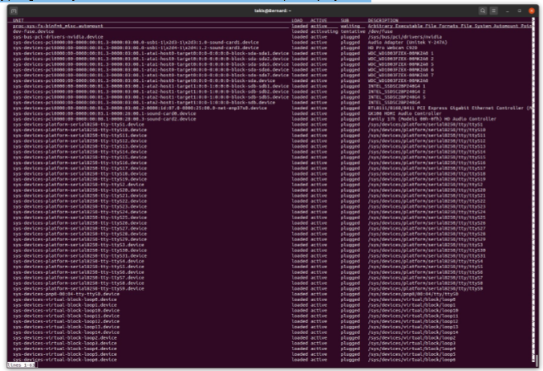
systemd
typing the systemctl command at the Linux prompt yields the following screen.
Tip: If you get locked up then, just press q for quit!

Slide 47
systemd
An example: If your beaglebone board has the correct time, that is only because it is obtaining it from your network. On recent Debian images this is performed by a systemd special unit.
debian@beaglebone:~$ sudo -i
root@beaglebone:~# systemctl status time-sync.target
• time-sync.target - System Time Synchronized
Loaded: loaded (/lib/systemd/system/time-sync.target; static;
vendor preset: enabled)
Active: active since Sun 2018-04-22 23:51:53 IST; 19min ago
Once the time is correct, use the following command, which provides a text-based user interface that allows you to choose your location. The board is now set for your local standard time (EST).
debian@beaglebone:~$ sudo dpkg-reconfigure tzdata

Slide 48
Assignment 2
Read the materials on pp. 85-90, Exploring Beaglebone, 2nd Edition.
Perform the following commands and show the outputs. What’s the meaning of each command?:
1. cp /lib/systemd/system/crond.service /lib/systemd/system/sleep.service
2. vi /lib/systemd/system/sleep.service
3. systemctl enable sleep.service
4. systemctl start sleep.service
5. systemctl status sleep.service
6. systemctl stop sleep.service;

Slide 49
Systemd: listening sockets
“A client socket does not listen for incoming connections. It initiates an outgoing connection to the server. The server socket listens for incoming connections.
A server creates a socket, binds the socket to an IP address and port number (for TCP and UDP), and then listens for incoming connections. When a client connects to the server, a new socket is created for communication with the client (TCP only). A polling mechanism is used to determine if any activity has occurred on any of the open sockets.
A client creates a socket and connects to a remote IP address and port number (for TCP and UDP). A polling mechanism can be used (select(), poll(), epoll(), etc) to monitor the socket for information from the server without blocking the thread.
In the case that the client is behind a router which provides NAT (network address translation), the router re-writes the address of the client to match the router's public IP address. When the server responds, the router changes its public IP address back into the client's IP address. The router keeps a table of the active connections that it is translating so that it can map the server's responses to the correct client.”

Slide 50
Systemd: listening sockets
there are a few things going on here:
first is the system-level operations of the network, amongst server, router, client (and the associated sockets)
second are the Unix-like system calls made to kernel (on either the server, router or client machines), in order to accomplish various tasks
various aspects of the TCP/IP or UDP protocols
one of the chief initial operations of systemd is to create a number of listening sockets for all the services that require it; note that systemd was developed initially under RedHat Linux, which is used predominantly on server platforms; your Beaglebone, is unlikely to require many listening sockets, although it is important to keep in mind that the Beaglebone Black is configured to be a web server by default under Debian Linux from beagleboard.org

Slide 51
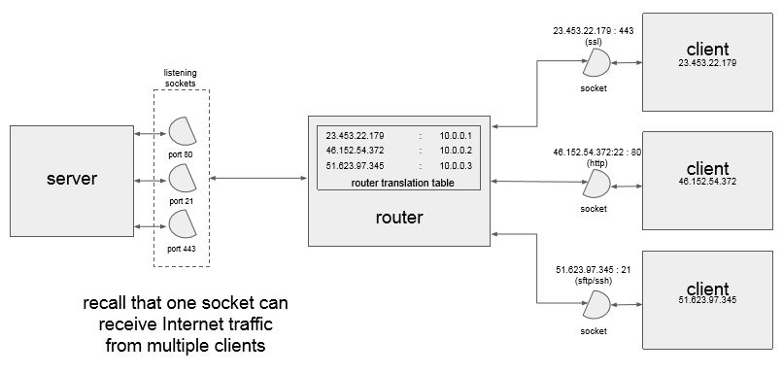
Systemd: listening sockets

Slide 52
systemd system and start-up features
the systemd system and service manager provides the following main features:
Socket-based activation — At boot time, systemd creates listening sockets for all system services that support this type of activation; and passes the sockets to these services as soon as they are started. This not only allows systemd to start services in parallel, but also makes it possible to restart a service without losing any message sent to it while it is unavailable: the corresponding socket remains accessible and all messages are queued. Systemd uses socket units for socket-based activation.
Bus-based activation — System services that use D-Bus for inter-process communication can be started on-demand the first time a client application attempts to communicate with them. Systemd uses D-Bus service files for bus-based activation.
Device-based activation — System services that support device-based activation can be started on-demand when a particular type of hardware is plugged in or becomes available. Systemd uses device units for device-based activation.
Path-based activation — System services that support path-based activation can be started on-demand when a particular file or directory changes its state. Systemd uses path units for path-based activation.

Slide 53
systemd system and start-up features
Mount and automount point management — Systemd monitors and manages mount and automount points. Systemd uses mount units for mount points and automount units for automount points.
Aggressive parallelization — Because of the use of socket-based activation, systemd can start system services in parallel as soon as all listening sockets are in place. In combination with system services that support on-demand activation, parallel activation significantly reduces the time required to boot the system.
Transactional unit activation logic — Before activating or deactivating a unit, systemd calculates its dependencies, creates a temporary transaction, and verifies that this transaction is consistent. If a transaction is inconsistent, systemd automatically attempts to correct it and remove non-essential jobs from it before reporting an error.
Backwards compatibility with SysV init — Systemd supports SysV init scripts as described in the Linux Standard Base Core Specification, which eases the upgrade path to systemd service units.

Slide 54
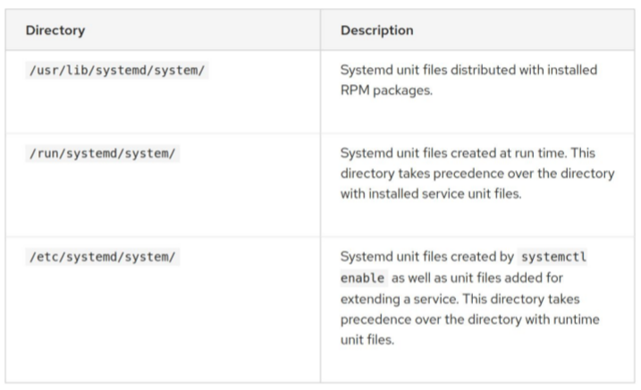
systemd units
Systemd introduces the concept of systemd units. These units are represented by unit configuration files located in one of the directories listed in the following Table, “Systemd Unit Files Locations”, and encapsulate information about system services, listening sockets, and other objects that are relevant to the init system.

Slide 55
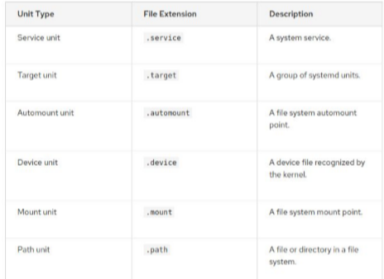
systemd units
For a complete list of available systemd unit types, see the following Table:

Slide 56
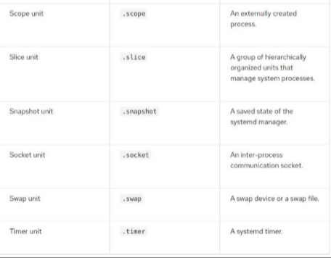
systemd units
Cont.,

Slide 57
relationship with SysV
under SysV, the system operates under various runlevels (See the Table on the next slide!)
for example, a runlevel of 0 corresponds to “halt the system (shutdown)”, a runlevel of 1 corresponds to single-user mode, while runlevels 2-5 correspond to multi-user mode
with systemd, these runlevels have been replaced by target units; you can determine your boards current default target as follows:
$ systemctl get-default
try this:
$ systemctl list-units --type=target

Slide 58
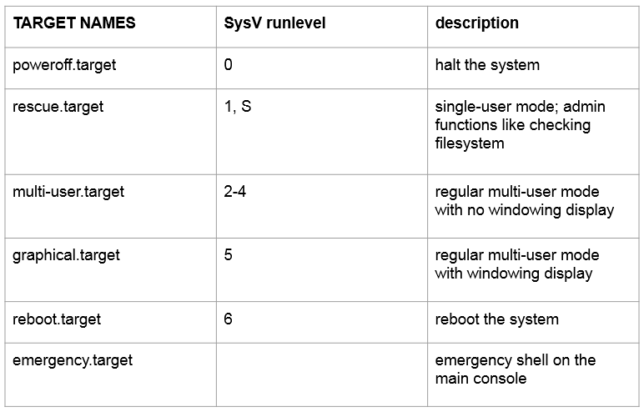
relationship with SysV

Slide 59
Creating a systemd service
It is simple to create a custom systemd service that will run any script or process you choose.
Although there are several ways to run a script or start a process when your Linode boots, a custom systemd service makes it easy to start, stop, or restart your script, as well as configure it to start automatically on boot.
systemd offers the advantage of using a standardized interface that is consistent across all Linux distributions that support it.

Slide 60
Creating a systemd service
to start the service:
$ sudo systemctl start myservice
to check on the status of the service:
$ sudo systemctl status myservice
to stop the service:
$ sudo systemctl stop myservice
to have it start automatically at boot:
$ sudo systemctl enable myservice

Slide 61
Lab #1: Creating a systemd service (VERY USEFUL!)
Step 1. First clone and review the program given you and try to compile and see whether the output of the program is as desired and if not make the necessary changes as required to be done using your knowledge of C programming. You might find the original file from the following link:
https://github.com/takiszourntos/teaching/blob/master/lambton/2020/fall/ese3005/class_2/workspace/test_service/src/test_service.c)
Step 2. create an executable C program (or bash script) and copy it to /usr/bin
Hint: The given paths in this lab are just for clarification purpose and you can have your own path!
Hint: When executing the file one may notice errors like “-bash: ./first: Permission denied” or it may not execute properly thus one can resolve it by changing the permission of file system object (Hint: Heard of chmod)
sudo cp your file.sh /usr/bin/ your file.sh
sudo chmod +x /usr/bin/ your file.sh

Slide 62
Lab #1: Creating a systemd service (VERY USEFUL!)
Step 3. create a systemd unit file
Hint: Once when you are satisfied with working of C program excuation that it produced the same output as desired. Now you must create a unit file as you desire (Refer to the type of units available). Remember you need to create a unit file which can run on boot up your options may include (Service Unit / Target Unit / Socket Unit) (Hint: Study each unit properly and know its usage. Ans. Service Unit)
Hint: A point to make here is that when writing the unit file be careful about the letters. This is a case sensitive file. That is [Unit] is not same as [UNIT] or [unit].
Hint: Also make sure that the file name which you use are not present in the system already as it will over-write the existing files preferably use something like myservice.service or yourname.service, etc or you alternatively type the command sudo systemctl list-unit-files --type-service to know about the list of service name already available in your machine.
Hint: In the unit file remember you basically should have a few sections namely referred to as [Unit], [Service] and [Install] and from the lectures you must by be aware that which directives should be used in these sections.

Slide 63
Lab #1: Creating a systemd service (VERY USEFUL!)
Hint:
File: /lib/systemd/system/myservice.service
[Unit]
Description=Example systemd service.
[Service]
Type=simple
ExecStart=/bin/bash /usr/bin// your file.sh
[Install]
WantedBy=multi-user.target
Hint: This defines a simple service. The critical part is the ExecStart directive, which specifies the command that will be run to start the service.

Slide 64
Lab #1: Creating a systemd service (VERY USEFUL!)
Step 4. copy the unit file to /etc/systemd/system/ and make it have “644” permissions using chmod
Hint: The unit file doesn’t need to be executable, but the permissions on the unit file should restrict who can edit it. You don’t want a malicious or mischievous user changing the unit file so that it executes a different program altogether
sudo cp myservice.service /etc/systemd/system/myservice.service
sudo chmod 644 /etc/systemd/system/myservice.service
Hint: This command will give the owner read and write permissions and read permissions to the group. Others will have no permissions.
Hint: In order to check if the syntax of your unit file is correct you can use the command “systemctl status htg.service”. If nothing is in red then the unit file is syntactically correct.
Hint: When you add a new unit file or edit an existing one, you must tell systemd to reload the unit file definitions.
sudo systemctl daemon-reload

Slide 65
Lab #1: Creating a systemd service (VERY USEFUL!)
Step 5. Use the enable command to ensure that the service starts whenever the system boots.
Hint:
sudo systemctl enable myservice
Step 6. Once you have a unit file, you are ready to test the service
Hint:
sudo systemctl start myservice
Step 7. Check the status of the service
Hint:
sudo systemctl status myservice
What is the output?
Step 8. The service can be stopped or restarted using standard systemd commands.
Hint:
sudo systemctl stop myservice
sudo systemctl restart myservice

Slide 66
Lab #1: Creating a systemd service (VERY USEFUL!)
Step 9. Disable your service.
Hint: When you stop the service, it doesn’t prevent it from restarting next time the computer is rebooted. To stop the service being launched at startup, you need to disable it.
sudo systemctl disable service-name.service
Tip: In most of the cases you may not require putting the extension “.service” but recommended.

Slide 67
Session – February 4

Slide 68
Why can’t the Beagle bone board display the correct date?
Because there is no backup battery on the board. In fact there is no BIOS/ UEFI on a BBB. So if we type $ date then it just show the date due to the last time the board was synchronized with a real time clock, RTC, or when it was connected to the Internet.

Slide 69
What’s the solution? Demonstrate it!
To resolve this issue we need to use the Network Time Protocol, NTP. Follow the following steps:
Step 1. Connect your board to the Internet using the cable:
debian@beaglebone: ~$ sudo –i
root@beaglebone:~ root add default gw 192.168.7.1
root@beaglebone”~ sudo bash –c ‘echo “nameserver 8.8.8.8” > /etc/resolv.conf’
Step 2. Now use the following command:
Debian@beaglebone:~$ sudo dpkg-reconfigure tzdata
Step 3. Select the proper time zone (America >> Toronto)

Slide 70
Systemd & Systemctl practicing
cp /lib/systemd/system/crond.service /lib/systemd/system/sleep.service
This command copies the cron service to sleep service. Meanwhile you can check if sleep service is already existing or not through:
Systemctl list-units-files | grep sleep
vi /lib/systemd/system/sleep.service
This command will open vim terminal to view, insert, or edit sleep service file (similar to nano)
systemctl enable sleep.service
This command will enable sleep service plus it creates symlink for sleep.service file into your targeted folder.

Slide 71
Systemd & Systemctl practicing
systemctl start sleep.service
It will start the service.
systemctl status sleep.service
This command will show the details of the service that it’s already running.
6. systemctl stop sleep.service; systemctl disable sleep.service
This command first stop the running service and then it will disable it.

Slide 72
Creating a systemd service
Step 1. First clone and review the program given you and try to compile and see whether the output of the program is as desired and if not make the necessary changes as required to be done using your knowledge of C programming:
For this we will go to this repository and clone it in our system by using git clone command
Step 2. create an executable C program (or bash script) and copy it to a proper directory/ subdirectory:
gcc -o test_service.sh test_service.c
sudo ./test_service.sh

Slide 73
Creating a systemd service
Step 3. create a systemd unit file
cd /lib/systemd/system
nano test_service.service
[Unit]
Description=a test service experiment!
[Service]
Type=simple
ExecStart=/home/Mike/Downloads/test_service
[Install]
WantedBy=multi-user.target
Don’t forget to save and exit!
Step 4. copy the unit file to /etc/systemd/system/ and make it have “644” permissions using chmod
sudo cp test_service.service to etc/systemd/system/test_service.service
sudo chmod 644 /etc/systemd/system/test_service.service

Slide 74
Creating a systemd service
Step 5. Use the enable command to ensure that the service starts whenever the system boots.
sudo systemctl enable myservice
Step 6. Once you have a unit file, you are ready to test the service
sudo systemctl start myservice

Slide 75
Creating a systemd service
Step 7. Check the status of the service
sudo systemctl status myservice
Step 8. The service can be stopped or restarted using standard systemd commands.
sudo systemctl stop myservice
Step 9. Disable your service.
sudo systemctl disable myservice

Slide 76
udev
Udev is a device manager for the Linux kernel. udev rules allow some control over devices on your system from within userspace, i.e., without requiring root access
using root access in Linux is discouraged because of the potential for harm to the filesystem if mistakes are made; it is, therefore, better to do your work on the system as a regular user as much as possible
udev was designed to make possible “hot pluggable” devices such as USB devices for video, sound or storage
access to udev is furnished through the udev admin tool;
to get a feel for this, try this command on your host machine:
$ udevadm monitor --kernel
now, plug in a flash drive to a USB port; what do you see?
now, eject the flash drive from the USB port, what do you see?
To quit the udevadm monitor press and hold ctrl+c

Slide 77
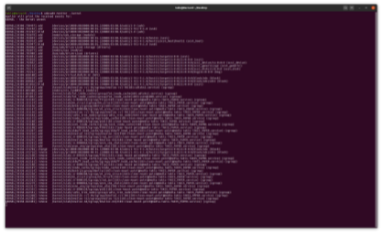
udev
typing the $ udevadm monitor command at the Linux prompt yields

Slide 78
Udev
udev allows for rules that specify what name is given to a device, regardless of which port it is plugged into. For example, a rule to always mount a hard drive with manufacturer "iRiver" and device code "ABC" as /dev/iriver is possible. This consistent naming of devices guarantees that scripts dependent on a specific device's existence work.
the udev system is composed of some kernel services and the udevd daemon. The kernel informs the udevd daemon when certain events happen. The udevd daemon is configured to respond to events with corresponding actions. The event information comes from the kernel - the actions happen in userspace. The responses to the events are configurable in "rules".
the userspace udev functionality is implemented by the systemd-udevd.service and its config file is in /etc/udev/udev.conf. The rules files (which amount to more configuration for udevd) are taken from /run/udev/rules.d, /etc/udev/rules.d or /lib/udev/rules.d. Packages install rules in /lib/udev/rules.d), while the /etc and /run locations provide a facility for the administrator to override the behavior of a package-provided rule.

Slide 79
udev
If a file with the same name is present in more than one of these directories then the latter(s) file will be ignored. Files there are parsed in alpha order, as long as the name ends with ".rules". When the config file or rules files are changed, the udevadm program should be used to instruct systemd-udevd to reload the rules (as we mentioned before: the userspace udev functionality is implemented by the systemd-udevd.service ). [the numbered prefixes of the file names therefore give an implicit priority to the rules]
The times when udevd (the udev daemon or background service) is active are:
1. at startup, it parses all the config files and rule files and builds a rules database in memory.
2. When an event happens, it checks its rule database and performs the appropriate actions.

Slide 80
udev
Rules for rules:
1. rules are all on one line (lines can be broken with\\ backslash character\\\\\\\\\ just before newline)
2. rules consist of "matches" and "actions"
3. matches and actions are "key" "operator" "value" triplets
4. matches have == or != for operator
5. actions have = (assignment) for operator
6. matches check one or more attributes of the event to see if the action will be applied
7. actions specify what will happen
8. example match: BUS=="usb"
9. example action: NAME="mydev"
10. example rule: KERNEL=="sd*[0-9]|dasd*[0-9]", ENV{ID_SERIAL}=="?*", (backslash character) \ SYMLINK+="disk/by-id/$env{ID_BUS}-$env{ID_SERIAL}-part%n"
11. all matching rules will fire
12. earlier rules have precedence over later rules - so put your customizations early in the rules.d file list
13. actions like key="value" override
14. actions like key+="value" add to the actions that are executed, e.g., SYMLINK+="foo" means "in addition to any other symlinks you were going to make for this event, also make one called foo"

Slide 81
udev
Rules for rule sets:
1. All the rules are in one big rule space, although they are divided into several files.
2. The only organization in the rule space is the ability to set labels, and then to skip a bunch of rules during "match this event to rules" time by jumping forward with a GOTO action.
3. there is one other rule type called a label: e.g., LABEL="persistent_storage_end" These are used by regular rules that have "GOTO" actions, e.g., ACTION!="add", GOTO="persistent_storage_end" Note that in this rule, the term ACTION is an attribute of an event and is being used as a condition for deciding if the GOTO action will be triggered.
4. It is polite to keep GOTOs to jump within a file (or you will have to worry about reordering the files)
5. Don't jump backwards to a label (didn't try it, but imagine it might end in an infinite loop? Maybe the udev code checks for that - but if it's going to be ignored (at best) why bother?)
6. You can set variables in ENV space in earlier rules and refer to them with later rules
7. The facility for dynamic rule creation exists (example: see z45_persistent-net-generator.rules)

Slide 82
udev
to determine the right kernel/attributes/system info for your udev rule, try:
examining the kernel ring buffer (messages the kernel creates) through dmesg command which is used for displaying system diagnostic messages as well as a list of devices attached to the system since the last reboot:
a. $ dmesg
b. $ dmesg | tail -n25
c. $ dmesg | grep “usb”
d. $ dmesg | grep “emmc” # searching for an emmc device
e. $ dmesg | grep “/dev/sdc”
using the udevadm tool, i.e., $ udevadm monitor
With the udevadm monitor command, you can tap into udev in real time and see what it sees when you plug in different devices. Become root and try it.
$ sudo -s
Question: What is the difference between $ sudo –i and $ sudo -s

Slide 83
udev
The [udevadm] monitor function prints received events for:
UDEV: the event udev sends out after rule processing
KERNEL: the kernel uevent
With udevadm monitor running, plug in a thumb drive and watch as all kinds of information is spewed out onto your screen. Notice that the type of event is an ADD event. That's a good way to identify what type of event you want.
Now that you have established where your drive is located in your filesystem, you can view udev information about that device with this command:
# udevadm info -a -n /dev/sdb | less
This returns a lot of information. Focus on the first block of info for now.

Slide 84
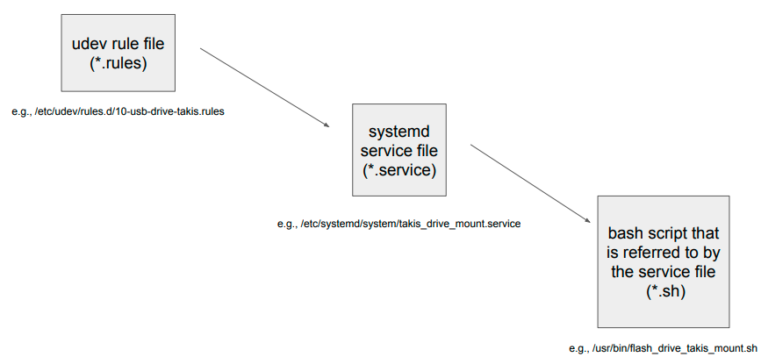
udev
Putting udev rule file and system service file

Slide 85
Lab #2: UDEV FILE FOR USB MOUNT
Aim: Create a udev rule file to mount USB!
Hardware Used: Beagle Bone and SanDisk USB (Connected Externally)
It might be useful to clone from the following link:
https://github.com/takiszourntos/teaching/blob/master/lambton/2020/fall/ese3005/class_3/udev_care_package.tar.gz
It might also be useful to follow the following steps:
Step 1 In order to mount the USB, first power up the BBB and look for if the device is mounted and check the path of the location. What is the proper command? Where is this device mounted?
Step 2 In order to mount the particular device to a designated folder you need to know the ID of that device which is unique. What is the proper command? What is your device UUID?
Step 3 Now lets create a folder we wish to designate to the USB and remember the folder should have the permission to read, write and execute thus the mode of the folder would be 777. What is the proper command?
Step 4 Now all the contents of the USB should be available in the folder we have created. To check if the folder is successfully created we use the command “ls”. How?

Slide 86
Session – February 11

Slide 87
Embedded Linux Development Tools
Besides utilizing an embedded Linux distribution, you can also build your own custom Linux OS stack with embedded Linux development tools. This gives you the most control and flexibility but in most cases requires more effort:
Baserock
Buildroot
OpenEmbedded
The Yocto Project

Slide 88
Baserock
Baserock is an open source project that provides a build system for Linux distributions, development environment, and a development workflow in one package.
Baserock’s major characteristics are
Git as the core to manage essentially everything from build instructions to build artifacts as a means to provide traceability
Native compilation to avoid the complexity of cross-build environments
Distributed builds across multiple systems using virtual machines
Currently, Baserock supports building for x86, x86_64, and ARMv7 architectures. The project’s homepage is at http://wiki.baserock.org.

Slide 89
Buildroot
Buildroot is a build system for complete embedded Linux systems using GNU Make and a set of makefiles to create a cross-compilation toolchain, a root filesystem, a kernel image, and a bootloader image. The project’s homepage is at http://buildroot.uclibc.org.
Buildroot mainly targets small footprint embedded systems and supports various CPU architectures. To jump start development it limits the choice of configuration options and defaults to probably the most commonly used ones for embedded systems:
uClibc is the target library to build the cross-compilation toolchain. In comparison to the GNU C Library (glibc), uClibc is much more compact and optimized for small footprint embedded systems. uClibc supports virtually all CPU architectures as well as shared libraries and threading.
BusyBox is the default set of command line utility applications.
These default settings enable building a basic embedded Linux system with Buildroot typically within 15 to 30 minutes, depending on the build host. However, these settings are not absolute, and the simple and flexible structure of Buildroot makes it easy to understand and extend. The internal cross-toolchain can be replaced by an external one such as crosstool-ng, and uClibc can be replaced with other C libraries.

Slide 90
Buildroot
Buildroot already supports many standard Linux packages, such as the X.org stack, GStreamer, DirectFB, and Simple DirectMedia Layer (SDL). The cross-toolchain can be used to build additional packages and have them included with the root filesystem.
Buildroot is very compact and straightforward to set up. A single-file (tarball) download and the installation of a few additional packages on the build host are all that are required to get started. After unpacking the tarball, the command make menuconfig launches a text-based user interface enabling configuration of a wide range of supported targets and setting of other options. In addition to menuconfig, Buildroot offers gconfig and xconfig, which are alternative graphical user interfaces.
Buildroot creates everything from source by downloading the source code files directly from the upstream projects. A nice feature is that offline builds can be done by downloading all the sources first using make source. Buildroot pre-fetches all necessary files and can then configure and run a build without further connectivity to the Internet.

Slide 91
OpenEmbedded
OpenEmbedded (www.openembedded.org) is a build framework composed of tools, configuration data, and recipes to create Linux distributions targeted for embedded devices. At the core of OpenEmbedded is the BitBake task executor that manages the build process.
Historically, OpenEmbedded was created by merging the work of the OpenZaurus project with contributions from other projects such as Familiar Linux and OpenSIMpad.
OpenEmbedded has been used to develop a variety of open source embedded projects, most notably the OpenMoko (http://wiki.openmoko.org) project dedicated to delivering a complete open source software stack for mobile phones.
OpenEmbedded, the Yocto Project, and the Ångström Distribution all have the same roots and build on and complement each other in various ways. We will explain the commonalities and differences in the next chapter when we dive into the details of the Yocto Project.

Slide 92
The Yocto Project
The Yocto Project: You can find its webpage at https://www.yoctoproject.org.
The Yocto Project is not a single open source project but represents an entire family of projects that are developed and maintained under its umbrella. We can describe many of the projects associated with the Yocto Project, in particular, Poky, the Yocto Project’s reference distribution, which includes the OpenEmbedded build system and a comprehensive set of metadata.
The embedded Linux landscape is diverse. This list is not all-comprehensive, and there are many more open source projects providing solutions for developing embedded devices with Linux. The projects mentioned here are, in my opinion, the most active and most commonly used ones. Before reading on, you may want to take some time and visit the web pages of these projects. They will give you a good understanding of what the goals of these projects are and how they compare to each other.

Slide 93
The Yocto Project
There are also a number of commercial offerings complementing the embedded Linux landscape. Commonly, these offerings include cross-development toolchains, distribution builders, application development IDEs, and more. An increasing number of operating system vendors for embedded systems are using the Yocto Project as an upstream. They use the Yocto Project tools to create their product lines. Many of them are members of the Yocto Project and support it with engineering and financial resources.

Slide 94
A Custom Linux Distribution
Let’s face it—building and maintaining an operating system is not a trivial task. Many different aspects of the operating system have to be taken into consideration to create a fully functional computer system:
Bootloader: The bootloader is the first piece of software responsible for initializing the hardware, loading the operating system kernel into RAM, and then starting the kernel. The bootloader is commonly multistaged with its first stage resident in nonvolatile memory. The first stage then loads a second stage from attached storage such as flash memory, hard drives, and so on.
Kernel: The kernel, as its name implies, is the core of an operating system. It manages the hardware resources of the system and provides hardware abstraction through its APIs to other software. The kernel’s main functions are memory management, device management, and responding to system calls from application software. How these functions are implemented depends on the processor architecture as well as on peripheral devices and other hardware configuration.
Device Drivers: Device drivers are part of the kernel. They provide application software with access to hardware devices in a structured form through kernel system calls. Through the device drivers, application software can configure, read data from, and write data to hardware devices.

Slide 95
A Custom Linux Distribution
Life Cycle Management: From power on to shutdown, a computer system assumes multiple states during which it provides different sets of services to application software. Life cycle management determines what services are running in what states and in what order they need to be started to maintain a consistent operating environment. An important piece of life cycle management is also power management, putting a system into energy saving modes when full functionality is not required, and resuming fully operational mode when requested.
Application Software Management: Application software and libraries make up the majority of software installed on a typical system, providing the end-user functionality. Frequently, many hundreds to multiple thousands of software packages are necessary for a fully operational system.

Slide 96
A Custom Linux Distribution
Linux and the plethora of open source software packages are like the building blocks of a construction kit. Unfortunately, it is more like a puzzle than like Legos. It can be a daunting task to figure out dependencies, incompatibilities, and conflicts between the different packages. Some packages even provide the same or similar functionality. Which one to choose? Eventually, you will have to draw your own blueprint to build the Linux distribution for your embedded project. In principal, you have two ways to go:
Top-down: In this approach, you start with one of the many available Linux distributions and customize it according to your requirements by adding and/or removing software packages. The author took this approach many years ago with a high-speed image processing system running on x86 server hardware. It is a viable approach and has its appeal because using a tested and maintained distribution alleviates some of the more tedious tasks of building and maintaining your own distribution. And you may be able to get support for it. However, it may limit you in your choice of hardware, since most off-the-shelf Linux distributions are built for x86 hardware. And, of course, picking the right distribution to start off with and rightsizing it for your target device is not that simple either.

Slide 97
A Custom Linux Distribution
Bottom-up: The bottom-up approach entails building your own custom Linux distribution from source code starting with a bootloader and the kernel and then adding software packages to support the applications for your target device. This approach gives you the most control (and you will learn a lot about Linux and operating systems in general), but it is also a challenging task. You will have to make many choices along the way, from selecting the right toolchain and setting kernel configuration options to choosing the right software packages. Some of these choices are interdependent, such as the choice of toolchain and target library, and taking the wrong turn can quickly send you down a dead end. After you have successfully built and deployed your own distribution, you are left with the burden of maintaining it—finding patches and security updates for the kernel and all the other packages you have integrated with your distribution.
This is where the strengths of the Yocto Project lie. It combines the best of both worlds by providing you with a complete tool set and blueprints to create your own Linux distribution from scratch starting with source code downloads from the upstream projects.

Slide 98
A Custom Linux Distribution
The blueprints for various systems that ship with the Yocto Project tools let you build complete operating system stacks within a few hours. You can choose from blueprints that build a target system image for a basic system with command-line login, a system with a graphical user interface for a mobile device, a system that is Linux Standard Base compliant, and many more.
You can use these blueprints as a starting point for your own distribution and modify them by adding and/or removing software packages. The remaining materials of this subject walk you through the entire process of building and customizing your Linux distribution and creating your own blueprints using the Yocto Project tools, which will give you repeatable results every time you build your system.

Slide 99
Jumpstarting Your First Yocto Project Build
Getting your hands dirty—or learning by doing—is undoubtedly the best way to acquire new skills. Consequently, we start by building our first Linux OS stack for use with the QEMU (short for Quick Emulator, a generic open source machine emulator for different CPU architectures).
You learn how to prepare your computer to become a Yocto Project development host, obtain and install the build system, set up and configure a build environment, launch and monitor the build process, and finally verify the build result by booting your newly built Linux OS stack in the QEMU emulator.

Slide 100
Prerequisites
You probably have guessed it: to build a Linux system with the Yocto Project tools, you need a build host running Linux:
Hardware Requirements
Internet Connection
Software Requirements

Slide 101
Hardware Requirements
Despite their capability to build Linux OS stacks, the Yocto Project tools require a build host with an x86 architecture CPU. Both 32-bit and 64-bit CPUs are supported. A system with a 64-bit CPU is preferred for throughput reasons. The Yocto Project’s build system makes use of parallel processing whenever possible. Therefore, a build host with multiple CPUs or a multicore CPU significantly reduces build time. Of course, CPU clock speed also has an impact on how quickly packages can be built.
Memory is also an important factor. BitBake, the Yocto Project build engine, parses thousands of recipes and creates a cache with build dependencies. Furthermore, the compilers require memory for data structures and more. The tools do not run on a system with less than 1 GB of RAM; 4 GB or more is recommended.

Slide 102
Internet Connection
The OpenEmbedded build system that you obtain from the project’s website contains only the build system itself—BitBake and the metadata that guide it. It does not contain any source packages for the software it is going to build. These are automatically downloaded as needed while a build is running. Therefore, you need a live connection to the Internet, preferably a high-speed connection.
Of course, the downloaded source packages are stored on your system and reused for future builds. You are also able to download all source packages upfront and build them later offline without a connection to the Internet.

Slide 103
Software Requirements
First of all, you will need a recent Linux distribution. The Yocto Project team is continually qualifying more and more distributions with each release. Using the previous to current release of one of the following distributions typically works without any issues:
CentOS
Fedora
openSUSE
Ubuntu
In general, both the 32-bit and the 64-bit variants have been verified; however, it is recommended that you use the 64-bit version if your hardware supports it. You can find a detailed list of all supported distributions in the Yocto Project Reference Manual located at www.yoctoproject.org/docs/current/ref-manual/ref-manual.html.

Slide 104
Obtaining the Yocto Project Tools
There are several ways for you to obtain the Yocto Project tools, or more precisely, the Yocto Project reference distribution, Poky:
Download the current release from the Yocto Project website.
Download the current release or previously released versions from the release repository.
Download a recent nightly build from the Autobuilder repository.
Clone the current development branch or other branches from the Poky Git repository hosted by the Yocto Project Git repository server.
The Yocto Project team releases a new major version of the build system every 6 months, in the April–May and October–November timeframes. All released versions of the Yocto Project tools have undergone multiple rounds of quality assurance and testing. They are stable and are accompanied with release notes and an updated documentation set describing the features. For Yocto Project novices, we recommend using the recent stable release.

Slide 105
Obtaining the Yocto Project Tools
Minor version releases that resolve issues but do not add any new features are provided as necessary between the 6-month release cycles. Since there are no new features, the documentation typically does not change with the minor releases.
Previous major and minor releases are archived and still available for download from the download repository. Sometimes new major releases introduce a new layer structure, new configuration files, and/or new settings in configuration files. Hence, migrating an existing build environment to the newer release may require migration effort. Staying with a previous release allows you to postpone or entirely put off migration.
Nightly builds track the current development status of the codebase in the Yocto Project Git repository. These builds have undergone basic quality assurance and Autobuilder testing. They are not tested as rigorously as the regular major and minor releases, but you get at least some confidence that the core functionality is operational.

Slide 106
Obtaining the Yocto Project Tools
Cloning the current development branch (master branch) from the Poky Git repository gives you direct access to the current state of the development effort. Modifications to this branch have not undergone any testing other than the tests the developers performed before signing off on their submissions. While the quality is generally high and any serious breakage of core functionality typically gets detected within a short period of time after a developer checked in a change, there is a good chance that the system may not work as expected. Unless you are directly involved in Yocto Project development, there is no immediate need to directly work with the master branch.
Besides the master branch, the Poky Git repository also contains milestone branches, development branches for the various versions, and a long list of tags referencing particular revisions of the various branches.
Navigate to https://www.yoctoproject.org/downloads and click on the latest release of Poky (DOWNLOAD YP CORE…). This URL directs you to a detailed download site with links to various download servers and mirrors. The site also contains the release information and an errata. Downloading the release places a compressed archive of the Poky reference distribution named poky--.tar.bz2 on your system.

Slide 107
Yocto Project Build System Overview
Poky: build system software used by the Yocto Project
Poky consists of two components: Bitbake + Metadata
Bitbake: a task executor and scheduler for managing and executing of all the build steps
Metadate: task definitions describing what is going to get built and how. Metadata is broken down into three types including:
Configuration (.conf) – global definitions of variables
Classes (.bbclass) – encapsulation and inheritance of build logic, packing, etc.
Recipes (.bb) – set of instructions for the logic units of the software/ images to build

Slide 108
Assignment #3 Poky Directory Tree Layout
Objective:
Familiarize yourself how the Poky metadata sources are organized
Learn where you can find conf files, class files, and recipe files
Instruction:
Ensure Poky on Ubuntu has already been downloaded and extracted
Explore Documentation subdirectory
How many meta subdirectories do you have?
Where are recipe file are located?
Where are class file are located?
Where is bitbake.conf located? What is this file for?
Where is qemux86-64.conf? What is this file for?
Explore scripts subdirectory?
Where is local.conf located? What is this file for?
Where is bblayers.conf located? What is this file for?

Slide 109
Session – February 18

Slide 110
Setting Up the Build Host
Setting up your build host requires the installation of additional software packages. All of the four mainstream Linux distributions have those packages readily available in their package repositories. However, they differ in what packages are preinstalled as part of the distribution’s default configuration.
After installing the additional packages, you need to unpack the Poky tarball, which includes all the necessary configuration data, recipes, convenience scripts, and BitBake. BitBake requires Python with a major version of 2.6 or 2.7.
user@ubuntu:~$ sudo apt install python2
BitBake currently does not support the new Python 3, which introduced changes to the language syntax and new libraries breaking backwards compatibility.

Slide 111
Setting Up the Build Host
What command to use and what additional packages to install depends on the Linux distribution you installed on your build host.
On an Ubuntu build, run the following command
user@ubuntu:~$ sudo apt-get install gawk wget git-core diffstat \\\\\\\ \\\\\\\\\\\\\\\\\\\\\\\\\\\\\\\\\ unzip texinfo gcc-multilib build-essential chrpath socat \ libsdl1.2-dev xterm
After a successful installation, you may want to verify that the correct version of Python has been installed: python2 --version. The output should show a major version number of 2.6 or 2.7.
Installing Poky merely requires unpacking the compressed tarball you downloaded from the Yocto Project website earlier. We recommend that you create a subdirectory in your home directory for all things related to your Yocto Project builds and follow the following necessary steps:
user@buildhost:~$ mkdir ~/yocto
user@buildhost:~$ cd ~/yocto
user@buildhost:~$ tar xvfj <downloadpath>/poky-<codename>-release.tar.bz2

Slide 112
Configuring a Build Environment
Now your build system is ready for setting up a build environment and creating your first Linux OS stack.
Poky provides the script oe-init-build-env to create a new build environment. The script sets up the build environment’s directory structure and initializes the core set of configuration files. It also sets a series of shell variables needed by the build system. You do not directly execute the oe-init-build-env script but use the source command to export the shell variable settings to the current shell:
$ source <pokypath>/oe-init-build-env
Executing the command creates a new build environment in the current directory with the name provided by the parameter . You may omit that parameter, and then the script uses the default build. After setting up the build environment, the script changes directory to the build directory
Use the script in the following form to create a new build environment as well as to initialize an existing build environment previously created. When creating a new build environment the script provides you with some instructions.

Slide 113
Configuring a Build Environment
You had no conf/local.conf file. This configuration file has therefore been created for you with some default values. You may wish to edit it to use a different MACHINE (target hardware) or enable parallel build options to take advantage of multiple cores, for example. See the file for more information, as common configuration options are commented.
The Yocto Project has extensive documentation about OE including a reference manual which can be found at: http://yoctoproject.org/documentation
For more information about OpenEmbedded see their website: http://www.openembedded.org/
You had no conf/bblayers.conf file. The configuration file has been created for you with some default values. To add additional metadata layers into your configuration, please add entries to this file.
The Yocto Project has extensive documentation about OE including a reference manual which can be found at: http://yoctoproject.org/documentation
For more information about OpenEmbedded see their website: http://www.openembedded.org/ ### Shell environment set up for builds. ### You can now run ‘bitbake ’
Common targets are:
core-image-minimal
core-image-sato
meta-toolchain
meta-toolchain-sdk
adt-installer
meta-ide-support
You can also run generated qemu images with a command like ‘runqemu qemux86’

Slide 114
Configuring a Build Environment
Inside the newly created build environment, the script added the directory conf and placed the two configuration files in it: bblayers.conf and local.conf. For now we look only at local.conf, which is the master configuration file of our build environment.
In local.conf, various variables are set that influence how BitBake builds your custom Linux OS stack. You can modify the settings and also add new settings to the file to override settings that are made in other configuration files. We explain this inheritance and how to use it with various examples throughout this course. For our first build, we focus on a few settings and accept the defaults for the remaining ones. If you open the local.conf file in a text editor, you find the variable settings shown in the following Listing
BB_NUMBER_THREADS ?= “${@bb.utils.cpu_count()}”
PARALLEL_MAKE ?= “-j ${@bb.utils.cpu_count()}”
MACHINE ??= “qemux86”
DL_DIR ?= “${TOPDIR}/downloads”
SSTATE_DIR ?= “${TOPDIR}/sstate-cache”
TMP_DIR = “${TOPDIR}/tmp”

Slide 115
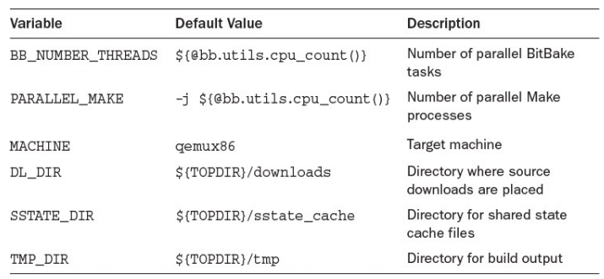
Configuring a Build Environment
Lines starting with the hash mark (#) are comments. If a hash mark precedes a line with a variable setting, you need to remove the hash mark for the settings to become active. The values shown are the default values. BitBake uses those values even if you do not enable them explicitly. The variable settings shown in the above Listing are the ones that you typically want to change after creating a new build environment. They are described in the following Table

Slide 116
Configuring a Build Environment
The default value for the two parallelism options BB_NUMBER_THREADS and PARALLEL_MAKE is automatically computed on the basis of the number of CPU cores in the system using all the available cores. You can set the values to less than the cores in your system to limit the load. Using a larger number than the number of physical cores is possible but does not speed up the build process. BitBake and Make spawn more threads accordingly, but they run only if there are CPU cores available. Never forget the quotes around the variable settings. Also note that for PARALLEL_MAKE, you have to include the -j, such as "-j 4" because this value is passed to the make command verbatim.
Setting the MACHINE variable selects the target machine type for which BitBake builds your Linux OS stack. Poky provides a series of standard machines for QEMU and a few actual hardware board target machines. Board support packages (BSPs) can provide additional target machines. For our first build, we choose qemux86, an emulated target machine with an x86 CPU.

Slide 117
Configuring a Build Environment
The variable DL_DIR tells BitBake where to place the source downloads. The default setting places the files in the directory downloads beneath the top directory of your build environment. The variable TOPDIR contains the full (absolute) path to the build environment. Source downloads can be shared among multiple build environments. If BitBake detects that a source download is already available in the download directory, it does not download it again. Therefore, we recommend that you set the DL_DIR variable to point to a directory path outside of the build environment. When you no longer need a particular build environment, you can easily delete it without deleting all the source file downloads.
The same holds true for the SSTATE_DIR variable, which contains the path to the shared state cache. The OpenEmbedded build system produces a lot of intermediate output when processing the many tasks entailed in building the packages comprising the Linux OS stack. Similar to the source downloads, the intermediate output can be reused for future builds and shared between multiple build environments to speed up the build process. By default, the configuration places the shared state cache directory beneath the build environment’s top directory. We suggest that you change the setting to a path outside the build environment.

Slide 118
Configuring a Build Environment
The variable TMP_DIR contains the path to the directory where BitBake performs all the build work and stores the build output. Since the output stored in this directory is very specific to your build environment, it makes sense to leave it as a subdirectory to the build environment. The amount of data stored in this directory can eventually consume many gigabytes of hard disk space because it contains extracted source downloads, cross-compilation toolchains, compilation output, and images for kernel and root file systems for your target machines and more.
To conserve disk space during a build, you can add
INHERIT += rm_work
which instructs BitBake to delete the work directory for building packages after the package has
been built.

Slide 119
Lab #3 Installation of Yocto Project
Step 1: Open up the Ubuntu terminal and clone poky from the GitHub repository
$ git clone https://git.yoctoproject.org/git/poky
Step 2: Change directory to Poky and see the list of available components there. What is the result?
$ cd poky
$ ls
Step 3: Use source script to set up the environmental variables and automatically changes to build subdirectory. See the list of available components. What i’’’s the result?
$ source oe-init-build-env
$ ls
Step 4: Change subdirectory to conf and see the list of available components. What’ is the result?
$ cd conf
$ ls

Slide 120
Lab #3 Installation of Yocto Project
Step 5: Open your local.conf file. How should you modify this file if you want to build the yocto project on the beagle bone instead of your host machine?
$ nano local.conf
Step 6: Now exit this editor (how?) and while ensure you are in build subdirectory run bitbake core-image-minimal. This kicks off the build and it takes an amount of time (depending on your CPU and RAM, e.g., if you have a quad-core CPU with 8 GB RAM it should take around 1 hour and half to build your first image of Yocto Project). What’ is the final message?
$ bitbake core-image-minimal

Slide 121
Launching the Build
To launch a build, invoke BitBake from the top-level directory of your build environment specifying a build target:
$ bitbake <build-target>
We go into detail about what build targets are and how to use them to control you build output in the following chapters. For our first build we use a build target that creates an entire Linux OS stack with a GUI. From the top-level directory of the build environment you created and configured during the previous sections, execute the following:
$ bitbake core-image-sato
The core-image-sato target creates a root file system image with a user interface for mobile devices. Depending on your build hardware and the speed of your Internet connection for downloading the source files, the build can take anywhere from one to several hours. You may also instruct BitBake to first download all the sources without building. You can do this with
$ bitbake -c fetchall core-image-sato

Slide 122
Launching the Build
After the download completes, you can disconnect your build system from the Internet and run the build offline at a later point in time.
BitBake typically immediately aborts a build process if it encounters an error condition from which it cannot recover. However, you can instruct BitBake to continue building even if it encounters an error condition as long as there are tasks left that are not impeded by the error:
$ bitbake -k core-image-sato
The -k option tells BitBake to continue building until tasks that are not dependent on the error condition are addressed.

Slide 123
Verifying the Build Results
Since our target machine is an emulated system, we can verify our build result by launching the QEMU emulator. For that purpose, Poky provides a convenient script that prepares the QEMU execution environment and launches the emulator with the proper kernel and root file system images:
$ runqemu qemux86
In its simplest form, the runqemu script is invoked with the machine target name. It then automatically finds the proper kernel and root file system images for the target in the build output. You have to enter your system administrator (or sudo) password for the script to set up the virtual network interface. The following Figure shows the running system.
You can terminate your QEMU virtual machine by clicking on the Shutdown button on the Utilities screen. This properly shuts down the system by running through the shutdown sequence. Alternatively, you can simply type Ctrl-C in the terminal where you launched QEMU.

Slide 124
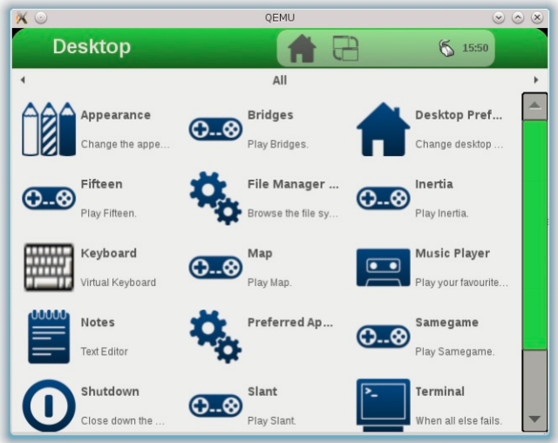
Verifying the Build Results

Slide 125
Yocto Project Build Appliance
If you simply would like to try out the Yocto Project and Poky without setting up a Linux build host, you can use the Yocto Project Build Appliance. The Build Appliance is a complete Yocto Project build host, including a Linux OS with the software packages required by the OpenEmbedded build system and Poky installed, bundled as a virtual machine image. It even already includes all the source package downloads, speeding up your first build and allowing you to build offline without a network connection.
The Build Appliance download is located on the Yocto Project website at https://www.yoctoproject.org/download/build-appliance-0. The Build Appliance is provided as a compressed ZIP archive that you need to unpack on your system after downloading it.
To utilize the Build Appliance, you need either VMWare Player or VMWare Workstation installed on your computer. You can obtain either one of them matching the operating system on your computer from the download section of VMWare’s website at www.vmware.com. Follow the installation instructions provided by VMWare.

Slide 126
Yocto Project Build Appliance
Once you have installed VMWare Player or VMWare Workstation, the Build Appliance manual at https://www.yoctoproject.org/documentation/build-appliance-manual provides detailed instructions on how to configure the virtual machine and boot the Build Appliance.
Booting the Build Appliance directly launches the Hob GUI for BitBake, as shown in the following Figure.
Select qemux86 from the drop-down box for the machine and core-image-sato for the base image. Then start the build. Depending on your host system and the virtual machine configuration, it may take multiple hours to build the image. You can observe the build process from the Log screen of Hob. The Log screen shows the packages to be built in a run-queue split up into the individual tasks. Currently running tasks are highlighted.
After the build completes, you can launch your image with the QEMU emulator directly from Hob.

Slide 127
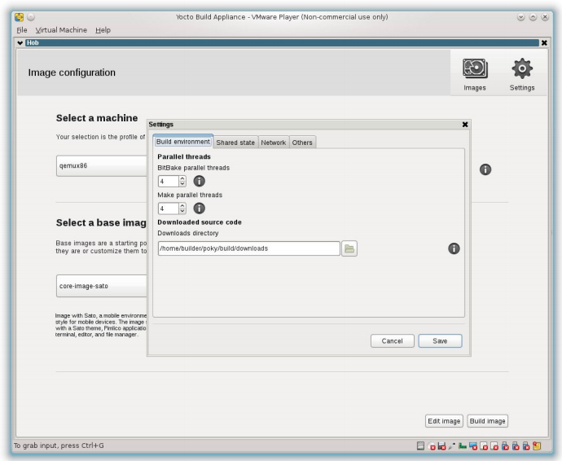
Yocto Project Build Appliance

Slide 128
The Yocto Project Family
The Yocto Project is not just a single open source project but combines multiple projects under one umbrella. You have already encountered the most prominent members of this family of projects: the OpenEmbedded build system, which includes BitBake and OpenEmbedded Core, and Poky, the Yocto Project reference distribution.
Essentially, all the members of the family support the OpenEmbedded build system. The Yocto Project team maintains the build system together with the OpenEmbedded Project, a separate organization. New functionality is added to the subprojects as the build system evolves.
The following Table provides an overview of the subprojects maintained as part of the Yocto Project.
Although there is tight integration of the subprojects within the Yocto Project, the developers ensure that there are no cross dependencies and that the subprojects are interoperable and can also be used independently without the build system.

Slide 129
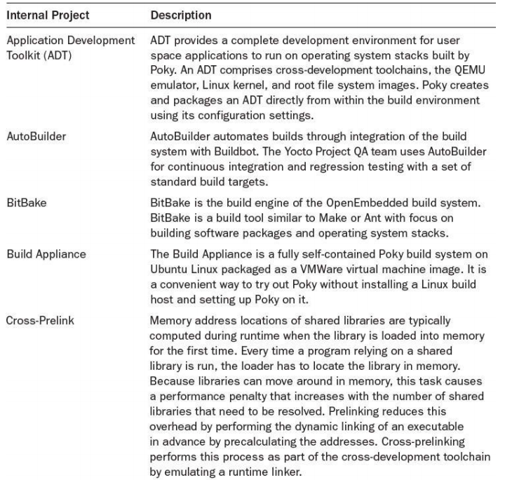
The Yocto Project Family

Slide 130
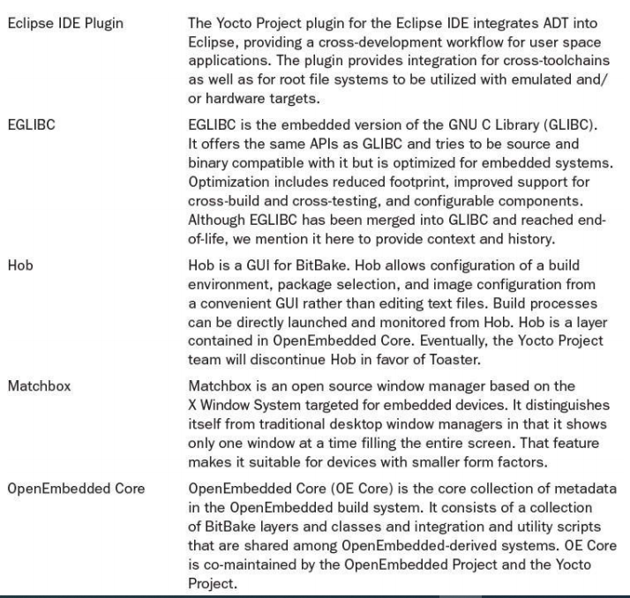
The Yocto Project Family

Slide 131
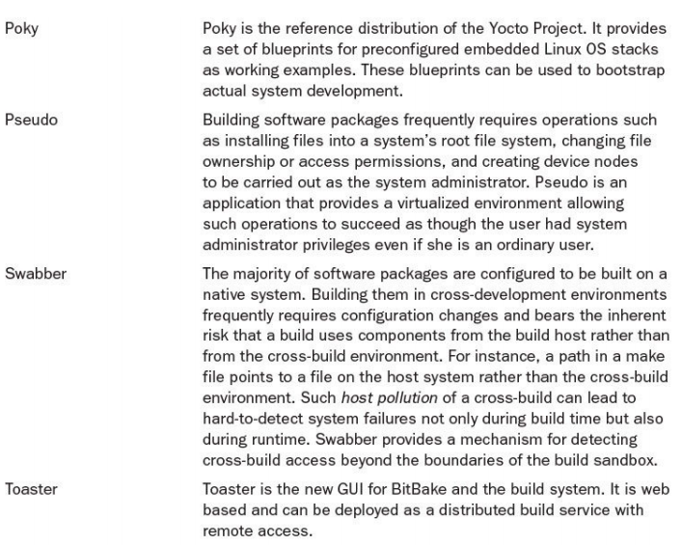
The Yocto Project Family

Slide 132
Yocto Project in Summary
YOCTO PROJECT: IT'S NOT AN EMBEDDED LINUX DISTRIBUTION, IT CREATES A CUSTOM ONE FOR YOU.
The Yocto Project (YP) is an open-source collaboration project that helps developers create custom Linux-based systems regardless of the hardware architecture.
The project provides a flexible set of tools and a space where embedded developers worldwide can share technologies, software stacks, configurations, and best practices that can be used to create tailored Linux images for embedded and IOT devices, or anywhere a customized Linux OS is needed.
What is hard about a custom Linux distribution?
Bootloader
Kernel
Device Drivers
Life Cycle Management
Application Software Management

Slide 133
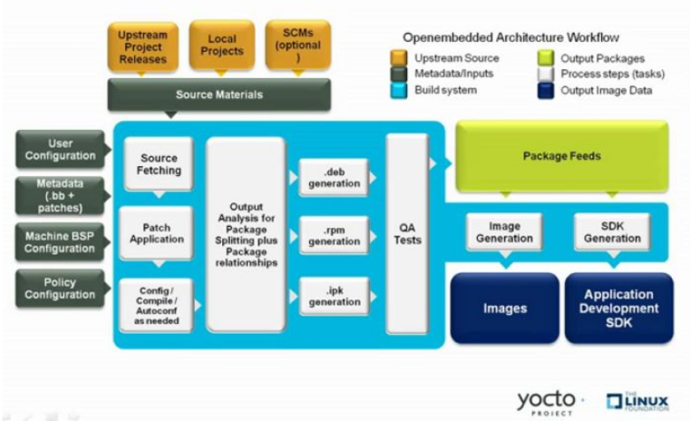
Yocto Project in Summary

Slide 134
Yocto Project in Summary
essentially, you use various configuration files and special script files called “recipes” to direct the build system in how to construct your Linux image
the image is then “flashed” on your embedded system
in this unit, we’ll be emulating the embedded system, so you won’’’’’’’’’’’’t have to worry about flashing a physical device!
the Yocto’s BitBake program then runs(BitBake is a core component of the Yocto Project and is used by the OpenEmbedded build system to build images), based on the configuration files and recipes goes through a repetitive process involving the same steps:
fetch (from many different sources on the Internet)
extract (un-zipping, un-archiving)
patch (updating the source code)
configure (configuring the build)
build (compiling, linking)
install (placing the program in the right directories, etc.)
package (creating the archive or image)

Slide 135
Session – February 25

Slide 136
Assignment #4 What is Sato?
In Lab #4, you will see that core-image-sato leads to have a game! This image with Sato support provides applications such as games, terminal editor, file manager, etc. for mobile devices. Do research about Sato and its applications and prepare a ppt file with at least 15 slides (March 3 Midnight).

Slide 137
Lab #4 YOCTO PROJECT AND QUEMU EMULATOR
Objective: launch the qemu desktop and play a game, win it and post the outputs of the screen (deadline: March 10 Midnight).
Software Language | N/A
Hardware Used | Host Machine
Operating System | Linux (Ubuntu 18.04 (LTS))
Image Used | Qemuarm
Other Notes | Usage of Yocto Project and bitbake recipes To load the qemu desktop takes time Used mainly keyboard when performing task inside the yocto project screen/ qemu desktop.

Slide 138
Lab #4 YOCTO PROJECT AND QUEMU EMULATOR
Step 1: First follow the last few steps that you did in Lab #3 which is like initialize the build environment. Therefore, you change your working directory first to poky and then type in the command
$ source oe-init-build-env
Step 2: On running this command you get to the build folder by default and then start to edit the local.conf file which is located in the build directory. In the local.conf file you should choose the image that you want to build (by default the value is qemuarmx86 but you should now change it. How? Tip: Look at the next steps to figure it out!).
Step 3: Try to create a root file system image with a user interface by this command
$ bitbake core-image-sato
Step 4: Launch yocto qemu desktop by this command
$ runqemu qemuarm
Step 5: Try to play the game and win!

Slide 139
Assignment #5 Bitbake Yocto Full Explanation
Let’’s review important concepts in Yocto Project and prepare a research ppt file through watching the video with the following link ((Deadline: March 17 Midnight).
https://www.youtube.com/watch?v=gn3XGLdfPfY

Slide 140
Lab #5 Toaster – Yocto Project
Toaster is a web interface to the Yocto Project’s OpenEmbedded Build System. The interface enables you to configure and run your builds. Information about builds is collected and stored in a database. You can use Toaster to configure and start builds on multiple remote build servers. Try to practice Toaster and show your skill with it using the related commands and steps (Deadline: March 28 Midnight).
Tip: You might watch the following video:
https://www.youtube.com/watch?v=BlXdOYLgPxA

Slide 141
Building with a BSP
A BSP (Board Support Package) simply is a metadata layer that contains a machine definition in the form of a configuration file with the name of the machine ending in .conf. Machine configuration files are located inside the conf/machine subdirectory of the BSP layer. To use a BSP, you have to add it to the BBLAYERS variable in the conf/bblayers.conf file of your build environment. You then have to set the MACHINE variable inside the conf/local.conf file of your build environment to the name of the machine you want to build for.
Technically, we have implicitly been using a BSP for our qemux86 builds throughout the preceding sections. You can find the machine definitions for qemux86 in the OE Core metadata layer of your build system at poky/meta/conf/machine/qemux86.conf. The OE Core metadata layer provides machine definitions for a variety of emulated machines for different architectures: qemuarm, qemuarm64, qemumips, qemumips64, qemuppc, qemux86, and qemux86-64. Providing machine definitions essentially qualifies the layer as a BSP layer.

Slide 142
Building with a BSP
The Yocto Project also includes its own BSP layer for actual hardware machines: nmeta-yocto-bsp. This layer is by default included in BBLAYERS of every build environment created with oe-init-build-env. It provides machine definitions for the Texas Instruments BeagleBone board, the Ubiquity Networks EdgeRouter, the Freescale MPC8351E-RDB Reference Platform, and generic 32-bit and 64-bit x86 platforms.
Building for any of these target platforms is simple. The file conf/local.conf already contains the MACHINE settings for them. You just need to uncomment the one you wish to build for.
Of course, this is only a very limited list of hardware platforms. The Yocto Project metadata includes them for convenience and test purposes. There are many other BSPs available from SoC, board vendors, and the community for a large variety of hardware.

Slide 143
Building for the BeagleBone
To build a Linux system for the BeagleBone with the OpenEmbedded build system, simply uncomment the line
MACHINE = “beaglebone”
in conf/local.conf of your build environment (and eventually comment out any other MACHINE
settings you have used previously). It does not matter that you have used the same build
environment before for building systems for a qemux86, a machine that is based on x86
architecture. However, if you prefer to keeps things separate, you can of course create a new build
environment by sourcing oe-init-build-env. If you do, make sure that you set DL_DIR and
SSTATE_DIR to the directories you previously used. It saves you a lot of time downloading shared
source packages and re-creating build artifacts that are shared between the architecture.
Now start your build with
$ bitbake -k core-image-minimal

Slide 144
Building for the BeagleBone
Once the build completes, you can find the images for the bootloader, Linux kernel, and root filesystem in the tmp/deploy/images/beaglebone subdirectory inside your build environment. The Poky build system neatly separates the images for different machines into their own directories so that they cannot get mixed up. Now what do you do with these images?
To be able to boot the target hardware, you need to understand how your target hardware, in our case the BeagleBone, boots its operating system. The BeagleBone boots from its external SD card in a specific way. You can find this information on BeagleBone.org. We summarize it here:
After power-on-reset (POR), the BeagleBone’s SoC loads and runs a stage 0 bootloader from its on-board ROM.
The stage 0 bootloader accesses a file called MLO, which must be located in the first sectors of the first partition on the SD card. MLO is a stage 1 bootloader that is provided by U-Boot’s secondary program loader (SPL) functionality.
The U-Boot SPL MLO configures the off-chip memory of the BeagleBone and then loads
the file u-boot.img, which is the full U-Boot bootloader. U-Boot is the stage 2
bootloader in this process.

Slide 145
Building for the BeagleBone
U-Boot then loads the Linux kernel image into memory and passes control on to the Linux kernel. U-Boot by default expects the kernel image uImage in the /boot directory of the second partition on the SD card. The second partition contains a Linux ext3 filesystem with the entire root filesystem for the BeagleBone.
The Linux kernel then begins its boot process, mounts the root filesystem as instructed by the kernel command line provided by the bootloader, and finally launches the first user space process.
The SD card requires a specific layout with two partitions: a small FAT boot partition and a Linux partition containing the root filesystem. The Linux partition for the root filesystem can be any file system supported by Linux, such as ext3 and ext4. The file README.hardware in the top directory of the Poky build system describes how to create the partitions and format them.
You can accomplish partitioning and formatting an SD card for booting the BeagleBone manually by following the instructions and using the commands fdisk, mkfs.vfat, and mkfs.ext3. However, automating the process with a little script is much more convenient. The following Listing shows a script for partitioning and formatting an SD card for the BeagleBone.

Slide 146
Building for the BeagleBone
Script for Partitioning and Formatting a BeagleBone SD Card
# (c) bbonesd.sh, 2015, Rudolf J Streif
#!/bin/sh
echo “Partitioning and formatting SD card for BeagleBone”
# test for the most common problems
test “$(id -u)” != “0” \\
&& echo “You need to be ‘root’ to run this script.” \
&& exit 1
test -z “$1” && \
echo “No disk device specified.” \
&& exit 1
test “$1” = “/dev/sda” \
&& echo “OOPS - System disk specified: ${1}” \
&& exit 1
# be sure before continuing
echo “Are you sure that you want to format ${1}? Type YES to proceed.”
read RESPONSE
test “$RESPONSE” != “YES” && echo “Exiting.” && exit 1
# now do the job
DRIVE=$1

Slide 147
Building for the BeagleBone
if [ -b “$DRIVE” ] ; then
dd if=/dev/zero of=$DRIVE bs=1024 count=1024
SIZE=`fdisk -l $DRIVE | grep Disk | awk ‘{print $5}’`
echo DISK SIZE - $SIZE bytes
CYLINDERS=`echo $SIZE/255/63/512 | bc`
echo CYLINDERS - $CYLINDERS
{
echo ,9,0x0C,*
echo ,200,0x83,-
echo ,,0x83,-
} | sfdisk -D -H 255 -S 63 -C $CYLINDERS $DRIVE
if [[ $1 == ‘/dev/sd’* ]] ; then
mkfs.vfat -F 32 -n “beagboot” ${DRIVE} 1
mkfs.ext3 -L “beagroot” ${DRIVE}2else
mkfs.vfat -F 32 -n “beagboot” ${DRIVE}p1
mkfs.ext3 -L “beagroot” ${DRIVE}p2
fi
fi
echo Done.

Slide 148
Building for the BeagleBone
After you insert an SD card into your development system, determine the device with the dmesg command:
$ dmesg
[ 4389.803854] sd 9:0:0:1: [sdf] 15278080 512-byte logical blocks: \
(7.82 GB/7.28 GiB)
[ 4389.822434] sdf: sdf1
In this example, the SD card has been recognized as /dev/sdf, so you need to invoke the script with
$ sudo ./bbonesd.sh /dev/sdf
The script works with SD cards recognized as SCSI drives (/dev/sd*, typically, when connected via a USB card reader) and also with SD recognized as memory block devices (/dev/mmcblk*, typically, when inserted into a card slot of a computer).
Now that we partitioned and formatted the SD card, we need to copy the bootloader and root filesystem to their respective partitions. The following assumes that the boot partition is mounted on /media/beagboot and the root partition is mounted on /media/beagroot.

Slide 149
Building for the BeagleBone
If your system mounts them to different mount points, you need to make adjustments accordingly. From the top-level directory of your build environment, change to the directory with the images for the Beaglebone
$ cd tmp/deploy/images/beaglebone
Copy the bootloader files to the boot partition:
$ sudo cp MLO /media/beagboot
$ sudo cp u-boot.img /media/beagboot
Extract the root filesystem and kernel modules into the root partition:
$ tar x -C /media/beagroot -f core-image-minimal.tar.bz2
$ tar x -C /medai/beagroot -f modules-beaglebone.tgz
Copy the kernel image and device tree files to the /boot directory of the root partition:
$ cp zImage /media/beagroot/boot
$ cp zImage-am335x-bone.dtb /media/beagroot/boot/am335x-bone.dtb
$ cp zImage-am335x-boneblack.dtb /media/beagroot/boot/am335x-boneblack.dtb

Slide 150
Building for the BeagleBone
Copying and extracting the files may take a while. Even when the last command returns, the process may not yet be completed, as Linux provides write buffers for disk operations. Use
$ sync
to flush all the buffers and wait for the command to return before unmounting and removing the
SD card. If you use umount from the command line, it waits for the filesystem buffers to be flushed
before unmounting, as sync is called by umount before the filesystem is actually unmounted.
Now you are ready to boot your BeagleBone board. To boot your BeagleBone board and to follow its boot process, you need to provide power for it and connect its console serial port to your development system.
Connecting the BeagleBone Black is a little bit difficult because this board does not have a built-in serial-to-USB converter. You need an external serial-to-USB converter cable, which is not provided with the BeagleBone Black. These cables are commonly referred to as FTDI cables after the company Future Technology Devices International Ltd. that produces the converter chips and the cables.

Slide 151
Building for the BeagleBone
The BeagleBone Black has a 6-pin, single-in-line 0.1-inch pitch connector on its top side. This is the connector for its serial console port. To connect to it, you need a serial-to USB converter cable with a USB A connector on one end and the 6-way, single-in-line connector on the other. You also need to pay attention to the signal levels of the BeagleBone Black’s serial console port, which are 3.3V. There are also cables for 5V signal levels. Using a 5V cable with the BeagleBone could damage your board’’ CPU. The correct cable is an FTDI TTL-232R-3V3. You can find it on FTDI’s website. Most component distributors carry these cables.
www.ftdichip.com/Products/Cables/USBTTLSerial.htm
To connect the cable to the board, set it topside-up with the Ethernet and 5V power connectors to the left. The black wire of the cable’s connector goes to the leftmost pin of the board’ connector. That pin is also marked with a little white dot on the board.
The serial-to-USB converter cable does not provide power to the BeagleBone. You can either connect a 5V power supply capable of providing at least 1.2A (or 6W) to the barrel connector, or you can use a USB A to mini USB cable. In most cases, the latter may be easier because the BeagleBone Black ships with such a cable. The USB cable connects to the mini USB port on the bottom side of the BeagleBone Black.

Slide 152
Building for the BeagleBone
To interact with the BeagleBone via serial connection, you need a terminal emulation program. There are a couple of choices for Linux. We recommend Minicom. Virtually any Linux distribution provides Minicom through its package repository. If it is not yet installed on your system, install it using your distribution’s package manager.
All current Linux systems recognize the FTDI serial-to-USB converters as ttyUSB devices. After you plug your BeagleBone into a USB port of your development computer, the device node /dev/ttyUSB0 is created by the Linux kernel. The Linux kernel protects device nodes from access by regular users. The /dev/ttyUSB devices are owned by root but also typically belong to the dialout user group. For Minicom to be able to access the device while running under your user account, you need to add yourself to the dialout user group:
(Unless you have more than one serial-to-USB converter connected to your development system,
in which case there are multiple /dev/ttyUSB devices, and you have to find out which one connects
to your BeagleBone.)
$ sudo usermod -a -G dialout <username>

Slide 153
Building for the BeagleBone
where you replace <username> with your actual username. You need to log out and log in again for the change to take effect.
Now connect your BeagleBone to your computer and launch Minicom in setup mode:
(Running Minicom in setup mode requires root privileges.)
$ sudo minicom -s
At this point, you should see Minicom’s setup menu. Select the Serial port setup menu
option and change the settings:
Serial Device to /dev/ttyUSB0
Bps/Par/Bits to 115200 8N1
Hardware Flow Control to No (if necessary)
Software Flow Control to No (if necessary)
Exit from the Serial port setup menu by pressing Enter, and then select Save as dfl from
the main setup menu. Finally, exit from Minicom.

Slide 154
Building for the BeagleBone
Now launch Minicom again with
$ sudo minicom -o –w
The -o option tells Minicom not to send any modem initialization strings to your BeagleBone, and
the -w option turns on line wrap for long lines.
Now you are connected to the console of your BeagleBone. If you hit Enter on your keyboard, you should see a Linux login prompt similar to this one:
Poky (Yocto Project Reference Distro) 1.8+snapshot-20150720 beaglebone \
/dev/ttyO0
beaglebone login:
If your board is a BeagleBone Black, you may just see the U-Boot prompt when you hit Enter. The reason for this is that the BeagleBone Black has internal eMMC storage. By default, the BeagleBone Black boots first from its internal eMMC. To temporarily tell it to boot from the SD card, follow these steps:

Slide 155
Building for the BeagleBone
Unplug power from the board (mini-USB or 5V barrel connector depending on what you are using).
Press and hold the USER/BOOT button on the board (the small button to the upperright on the top side of the board when Ethernet and 5V power connector are facing to the left).
Plug in power again while still holding the USER/BOOT button until the first messages from U-Boot appear in your Minicom window. You can then release the button.
Your BeagleBone boots and eventually shows the Linux login prompt. You can permanently change the boot order from internal eMMC to SD card by issuing these commands from the U-Boot command prompt:
mmc dev 1
mmc erase 0 512
This erases the content from internal eMMC. From the Linux command prompt, you can log in to your system running on the BeagleBone.
Congratulations, you have successfully created a Yocto Project image for an embedded
board and used it to boot the board.

Slide 156
Session – March 4

Slide 157
Lab #6 Building Yocto for the Beaglebone and Quemulator
Part A: Goal) Create an Image for BeagleBone Black preferably minimal image using the Yocto project and make the Beaglebone run from the image flashed on the MicroSD Card. (Deadline: March 31 Midnight).
Step 1: Change your working directory first to poky and then type the following command. What will happen?
$ source oe-init-build-env build_bbb
Step 2: Switch to conf subfolder and open local.conf file. How?
Step 3: Try to select beaglebone-yocto as your target machine there. Demonstrate it!
Step 4: Also, in your local.conf file ensure the following statements are uncommented. Why?
DL_DIR ?= “${TOPDIR}/downloads”
SSTATE_DIR ?= “${TOPDIR}/sstate-cache
DISTRO ?= “poky”
PACKAGE_CLASSES ?= “package_rpm”

Slide 158
Lab #6 Building Yocto for the Beaglebone and Quemulator
Step 5: Once the file is ready, save the file and then run the bitbake command. Do you remember the command? Since your target is beagle bone thus you build the beagle bone image which is the minimal image. The minimal image is the minimal bootable image, which includes support for SSH and so is used here. The minimal image as the name suggests will have the minimum functionality and commands. As you know, building images for the desired target may take some time, depending on the network speed and processing power.
Step 6: Once you are done successfully now check the path poky/build_bbb/tmp/deploy/images/beaglebone-yocto. What files can you see there?
Step 7: Next, you will insert the microSD card into the host machine. Once inserted, check if the microSD card has been mounted; the screen illustrates the same. Use the dmesg command as follows. What is this command for? What is the name of your card?
$ dmesg | tail
Tip: I recommend you to use another SD card and not the one you are using to image Debian into
the beagle bone! Why?

Slide 159
Lab #6 Building Yocto for the Beaglebone and Quemulator
Step 8: Unmount the probable existing partitions using the “unmount” command . Why do we need to do it?
$ unmount /dev/<your card name>
Step 9: Now launch the fdisk utility for partitioning:
$ sudo fdisk /dev/<your card name>
Step 10: As you see you’ will be prompted to enter proper commands like d, n, a, or t for the process of partitioning (https://www.tecmint.com/fdisk-commands-to-manage-linux-disk-partitions/). You need to create the first partition, then move to make the second partition, then enable bootable flag on partition 1 , as well as changing type of this partition to FAT32 file system and in the last save the changes on the SD card by using the write command (i.e., write all the changes on the SD Card). Tip: You might use command m to get help for completing step 10
Step 11: Now it’ is time to firstly format the first partition using the following command. What is the impact of this command?
$ sudo mkfs.vfat –n “BOOT” /dev/<your card name>

Slide 160
Lab #6 Building Yocto for the Beaglebone and Quemulator
Step 12: and secondly to format the second partition using the following command. What is the impact of this command?
$ sudo mkfs.ext4 –n “ROOT” /dev/<your card name>
Step 13: Now you should copy the files into the SD card by first mounting both the partitions using the mount command as shown in the screens. At first change directory to the path mentioned in step 6 and then try to copy the MLO, U-Boot into FAT32 and the kernel image in the boot partition along with .dtb file (which is necessary only for core-image-minimal):
$ sudo co MLO /media/$USER/BOOT
$ sudo co u-boot.img /media/$USER/BOOT
$ sudo co zImage/media/$USER/BOOT
Step 14: Once all the above steps completed you need to insert the microSD card in the beaglebone black and then start it to boot through the SD card. Once booted through the SD card you communicate with beagle bone through the serial communication such as Minicom or screen. Try Minicom. For this purpose, do you need to install Minicom? Which cable shall you use then?

Slide 161
Lab #6 Building Yocto for the Beaglebone and Quemulator
Step 15: Now login into the beagle bone, the username is root and the password is blank i.e. not applicable by default.
Step 16: Try to see what commands are available in the image. How? Why do we have such limited number of commands there?
Par B: Goal) Create an Image for BeagleBone Black preferably sato image using the Yocto project which has the GUI and make the Beaglebone run from the image flashed on the MicroSD Card and display the GUI using a screen.
Step 1: Change your working directory first to poky and then type the following command.
$ source oe-init-build-env build_bbb
Step 2: Switch to conf subfolder and open local.conf file.

Slide 162
Lab #6 Building Yocto for the Beaglebone and Quemulator
Step 3: Try to select beaglebone-yocto as your target machine there. Also, in your local.conf file ensure the following statements are uncommented.
DL_DIR ?= “${TOPDIR}/downloads”
SSTATE_DIR ?= “${TOPDIR}/sstate-cache
DISTRO ?= “poky”
PACKAGE_CLASSES ?= “package_rpm”
Step 4: Once the file is ready, save the file and then run the bitbake command, but this time try to build the sato image for the beagle bone. The Sato Image is the bootable image, which includes support for GUI as we have seen in the previous reports when combined with QEMU Emulator and so is used here. Do you remember the command? As you know, building images for the desired target may take some time, depending on the network speed and processing power.
Step 5: Once you are done successfully now check the path poky/build_bbb/tmp/deploy/images/beaglebone-yocto. What files can you see there?

Slide 163
Lab #6 Building Yocto for the Beaglebone and Quemulator
Step 6: Next, you will insert the microSD card into the host machine Use the dmesg command as follows.
$ dmesg | tail
Step 7: This time instead of formatting and partitioning your SD card in the way you did in Lab #6, Part A, I recommend to use dd command whose primary purpose is to convert and copy the files and make an image on the SD card. Explain about the following command in more details!
$ sudo dd if=core-image-satobeaglebone-yocto.wic of=/dev/<your card name>
Step 8: Once all the above steps completed, you need to insert the microSD card in the beaglebone black and then start it to boot through the SD card. Once booted through the SD card and connect it through the micro HDMI to HDMI cable to a screen like a device such as a monitor or a television screen. Explain about this cable in more details! What can you see on the screen now?.

Slide 164
External Yocto Project BSP
The Internet of Things and the Maker Movement are driving the demand for inexpensive computer hardware.
Professional developers and hobbyists alike are looking for development boards that they can use for designs and prototypes and integrate with their projects.
A steadily increasing number of boards is available built around a large variety of SoCs.
The vast majority uses silicon that is based on ARM architecture, but x86, x86_64, xScale, and PowerPC can also be found.
The Raspberry Pi has set a new benchmark for a low-cost embedded computer capable of running a full Linux OS stack.
Other boards have followed suit, and many of them set you back only as much as a good dinner in a decent restaurant.

Slide 165
Popular Development Boards
The following Table shows, in alphabetical order, some of the more popular development boards capable of running Linux.
They all provide various low-speed I/O interfaces that are readily accessible via pin headers.
For some of them, expansion boards are available that directly plug on to the headers.
Expansion boards offer anything from parallel I/O with LED status and relays to analog-to-digital (ADC) and digital-to-analog (DAC) converters to stepper motor drivers for robotic applications and much more.

Slide 166
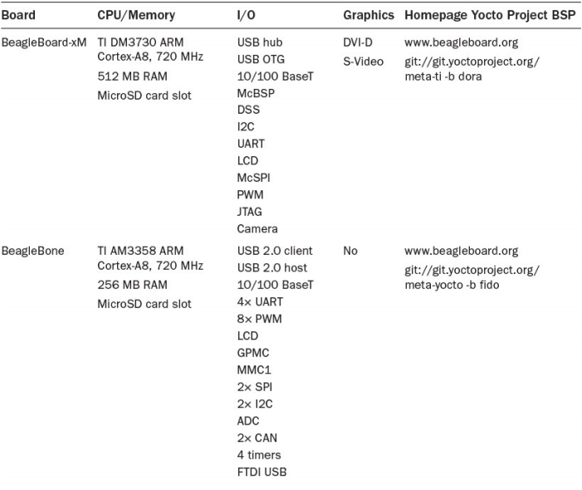
Popular Development Boards

Slide 167
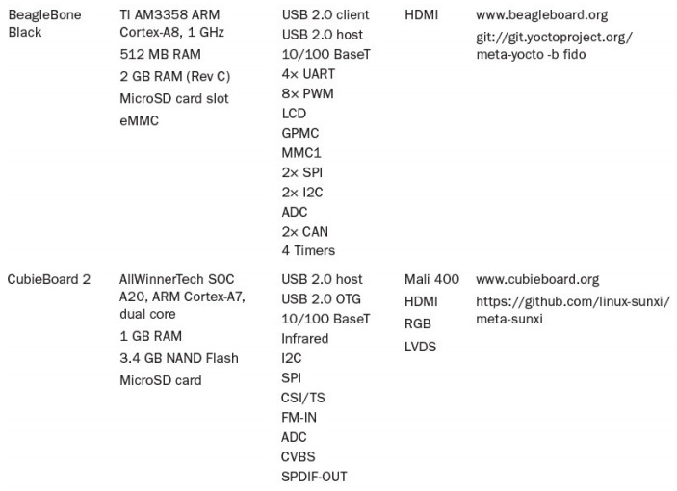
Popular Development Boards

Slide 168
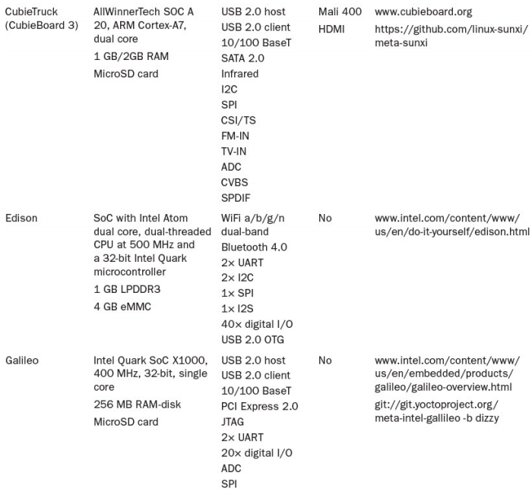
Popular Development Boards

Slide 169
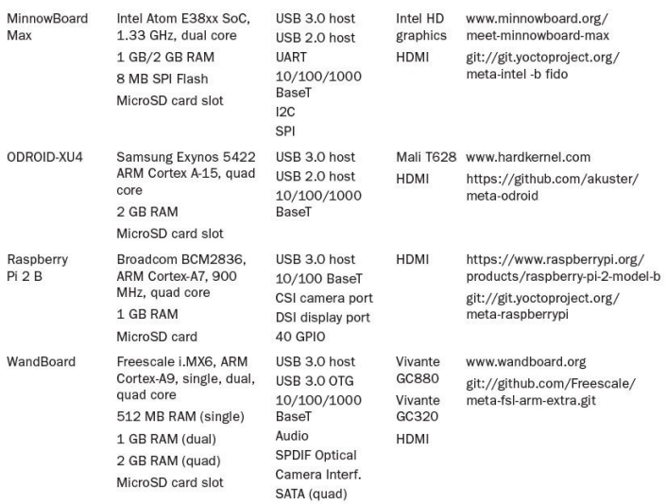
Popular Development Boards

Slide 170
Finding the Yocto Project BSP for Your Board
Once you have decided on the board for your next development project, where do you find development boards supported by Yocto Project BSP?
A good starting point is the website for the board itself. In many cases, you can find links to the Yocto Project or to a community providing hardware support.
The Yocto Project maintains a searchable BSP page on its website with an overview of the boards and BSPs that are hosted on Yocto Project repositories.
These BSPs are provided by organizations, commercial and open source, that support the Yocto Project through resources and development work.
Some are listed as Yocto Project Compatible, a status that functions as a recognition by the Yocto Project of organizations who support the project.

Slide 171
Finding the Yocto Project BSP for Your Board
Yocto Project Compatible does not imply that layers without that status are incompatible, only that those layers listed as Yocto Project Compatible have gone through a vetting process and are supported by a Yocto Project member organization.
The Yocto Project Git repository hosts many BSP layers, including ones that are not officially Yocto Project certified.
The list of BSP layers includes the following:
meta-fsl-arm: BSP layer for Freescale platforms using SoC based on ARM architecture.
meta-fsl-ppc: BSP layer for Freescale platforms using SoC based on PowerPC architecture.
meta-intel: Compound BSP layer for Intel platforms based on x86 and x86_64 architectures. This layer contains multiple sublayers for the actual platforms.
meta-intel-galileo: BSP layer for Intel Galileo platform support.
meta-intel-quark: BSP layer for Intel Quark platform support.

Slide 172
Finding the Yocto Project BSP for Your Board
meta-minnow: BSP layer for the original MinnowBoard (not the MinnowBoard Max, which is supported by meta-intel).
meta-raspberrypi: BSP layer for Raspberry Pi 1 and Raspberry Pi 2 devices.
meta-renesas: BSP layer for Renesas devices.
meta-ti: BSP layer for Texas Instruments devices, including extended hardware support for the BeagleBone that is not provided by meta-yocto-bsp.
meta-xilinx: BSP layer for Xilinx devices.
meta-zynq: BSP layer for Zynq devices

Slide 173
Building with an External Yocto Project BSP (Summary)
Yocto Project BSPs are layers, and building with them is as easy as 1-2-3:
Step 1. Include the BSP layer with your build environment by adding its path to the BBLAYERS variable in conf/bblayers.conf.
Step 2. Assign the machine from the BSP you want to build for to the MACHINE variable in conf/local.conf.
Step 3. Choose an image target and start your build—for instance, bitbake -k coreimage-minimal. It is good advice to start with a small image, just capable of booting to the console command line, such as core-image-minimal or core- image-base. If that works, you can test a larger image such as core-imagesato or start building your own custom image recipe. Some BSPs contain their own image targets, which are a good starting point too.

Slide 174
Session – March 11

Slide 175
Assignment #6 An overview on Yocto + QUIZ
To review on what we have learned during the previous sessions, watch the video with the following link in class, take notes, and at the end the instructor will ask you questions based on the video. (Deadline: In-class Activity)
https://www.youtube.com/watch?v=-J2Om1S-kBM

Slide 176
Session – March 18

Slide 177
Setting Up a Cross-Compilation Toolchain
You have learnt how all of the code is built and executed directly on the Beagle boards. However, for larger projects this can be impractical, as you may need to manage many source files within a single project.
In addition, compilation times can be slow on the Beagle boards for building large projects. Here we want to describe how you can use your desktop computer (through establishing a full-featured cross-compilation environment) to develop applications that can be deployed directly to any Beagle board.
To define the cross-compilation tool one can define it as a code compiling tool for one computer system on another or different computer system which is mainly called the host. In other words, one can say a tool that compiles from one architecture to another architecture. It can be used when the target system is too small for the host and their application includes in the embedded system design and for gaming console usage. Keeping this definition in mind one can say that the task is to get the executable for just for our beaglebone black which has the arm architecture as compared to the host which of the Intel x86 architecture.

Slide 178
Setting Up a Cross-Compilation Toolchain
Linux is generally used on the desktop computer for this task, as cross-compiling code that is written under Windows/macOS to run on an ARM Linux device is a challenging process, particularly when integrating third-party libraries. Therefore, if you are using Windows/macOS you can use the VirtualBox configuration.
The environment and configuration for cross-platform development are ever-evolving processes. The primary aim is to ensure that you grasp the concepts behind cross-compilation and that you see practical examples of the tools in use.
The first step in cross-compiling Linux applications is the installation of a Linux toolchain. A toolchain is suitably named, as it is a set of software development tools and libraries (such as gcc, gdb, glibc) that are chained together to enable you to build executable code on one operating system on one type of machine, such as a 64-bit Linux OS on an Intel x86 machine, but to execute them on a different operating system and/or a different architecture, such as a 32-bit Linux OS on an ARM device.

Slide 179
Setting Up a Cross-Compilation Toolchain
This section assumes that the sudo tool is available on your desktop machine. You must also ensure that your user account is in the sudo group.
molloyd@desktop:~$ more /etc/hostname desktop
molloyd@desktop:~$ groups
molloyd cdrom floppy sudo audio dip video plugdev netdev bluetooth
Scanner
If not, use a root terminal or console to add the user to the sudo group:
root@desktop:~# adduser molloyd sudo
To begin, you can discover detailed information about your Linux version on your Beagle board by typing the following commands individually or together using &&. This information is valuable when deciding which particular toolchain to use.
debian@ebb:~$ uname -a && cat /etc/os-release && cat /proc/version
Linux ebb 4.14.44-ti-rt-r51 #1 SMP PREEMPT 2018 armv7l GNU/Linux
PRETTY_NAME="Debian GNU/Linux 9 (stretch)" ...
Linux version 4.14.44-ti-rt-r51 (Debian 6.3.0-18+deb9u1)
#1 SMP PREEMPT Fri Jun 1 08:15:35 UTC 2018

Slide 180
Cross-Compiling Under Debian
Traditionally, installing a toolchain was a complex task that involved the integration of many different tools and platform configurations.
Thankfully, the latest versions of Debian have strong support for cross-building through the cross-toolchain repository.
There are other toolchains available, such as Linaro (www.linaro.org/downloads/), but the Debian cross toolchain is a good starting point. You can list the available toolchains as follows:
molloyd@desktop:~$ apt-cache search cross-build-essential
crossbuild-essential-arm64 - Info list of cross-build-essential packages
crossbuild-essential-armel - Info list of cross-build-essential packages
crossbuild-essential-armhf - Info list of cross-build-essential packages
crossbuild-essential-mipsel - Info list of cross-build-essential packages
crossbuild-essential-powerpc - Info list of cross-build-essential packages
crossbuild-essential-ppc64el - Info list of cross-build-essential packages

Slide 181
Cross-Compiling Under Debian
You need the ARM hard float (armhf) package for building software that is deployed to the Beagle boards.
molloyd@desktop:~$ sudo apt install crossbuild-essential-armhf
Setting up gcc-6-arm-linux-gnueabihf (6.3.0-18cross1) ...
Setting up g++-6-arm-linux-gnueabihf (6.3.0-18cross1) ...
Setting up crossbuild-essential-armhf (12.3) ...
The installation can be tested by calling the compiler directly.
molloyd@desktop:~$ arm-linux-gnueabihf-g++ -v
COLLECT_GCC=arm-linux-gnueabihf-g++ ...
Thread model: posix
gcc version 6.3.0 20170516 (Debian 6.3.0-18)
The compiler name is preceded by a triple X-Y-Z, where X identifies the architecture as arm, Y identifies the vendor (typically absent for Linux), and Z identifies the application binary interface (ABI) as linux-gnueabihf.

Slide 182
Cross-Compiling Under Debian
The embedded ABI (EABI) defines a standardized machine-code-level interface between compiled programs, compiled libraries, and the OS, which aims to ensure that binary code created with one toolchain can be linked with a project that uses a different toolchain or compiler.
Therefore, linux-gnueabihf can be read as the GNU EABI for Linux that supports hardware-accelerated floating-point operations (i.e., hard floats). Hard float operations are much faster than soft float operations as they take advantage of the microprocessor’s on-chip floating-point unit (FPU), rather than having to perform the calculations using software (i.e., soft floats).

Slide 183
Testing the Toolchain
You can test that the toolchain is working correctly by writing a short C++ program, testcross.cpp, which can be compiled into binary code using the cross-compiler.
molloyd@desktop:~$ nano testcross.cpp
molloyd@desktop:~$ more testcross.cpp
#include<iostream>
using namespace std;
int main(){
cout << "Testing cross compilation for armhf" << endl;
return 0;
}
molloyd@desktop:~$ arm-linux-gnueabihf-g++ testcross.cpp -o testcross
molloyd@desktop:~$ ls -l testcross*
-rwxr-xr-x 1 molloyd or 9184 Jun 6 19:05 testcross
-rw-r--r-- 1 molloyd row 125 Jun 6 19:03 testcross.cpp
The binary file has an executable flag, but when the binary is invoked, it fails to execute. This is unsurprising, as we are attempting to execute ARM binary instructions on an Intel x86 machine.
molloyd@desktop:~$ ./testcross
bash: ./testcross: cannot execute binary file: Exec format error

Slide 184
Testing the Toolchain
However, the program can be transferred to a Beagle board using sftp as follows:
molloyd@desktop:~$ sftp debian@192.168.7.2
debian@192.168.7.2's password:
Connected to 192.168.7.2.
sftp> put testcross
Uploading testcross to /home/debian/testcross
sftp> bye
Then SSH to the Beagle board from the desktop machine to confirm that the program works correctly.
molloyd@desktop:~$ ssh debian@192.168.7.2
debian@192.168.7.2's password: temppwd
debian@ebb:~$ ls -l testcross
-rwxr-xr-x 1 debian temped 9184 Jun 4 05:59 testcross
debian@ebb:~$ ./testcross
Testing cross compilation for armhf
Success! If you see this output, then you are able to build a binary on the desktop
machine that can be executed directly on the Beagle board.

Slide 185
Testing the Toolchain
Finally, you can use the ldd tool to display the shared library dependencies of the program, which can be useful in debugging dependency problems.
debian@ebb:~$ ldd testcross
linux-vdso.so.1 (0xbef55000)
libstdc++.so.6 => /usr/lib/arm-linux-gnueabihf/libstdc++.so.6 (0xb6e9b000)
libm.so.6 => /lib/arm-linux-gnueabihf/libm.so.6 (0xb6e23000)
libgcc_s.so.1 => /lib/arm-linux-gnueabihf/libgcc_s.so.1 (0xb6dfa000)
libc.so.6 => /lib/arm-linux-gnueabihf/libc.so.6 (0xb6d0c000)
/lib/ld-linux-armhf.so.3 (0xb6fb9000)

Slide 186
Emulating the armhf Architecture
A package called QEMU can be installed on the desktop machine so that it can emulate the armhf architecture. This is called user-mode emulation.
QEMU can also perform full computer-mode emulation, just like VirtualBox.
You can install the QEMU user-mode emulation as follows (please check that you are back on the desktop machine):
molloyd@desktop:~$ sudo apt install qemu-user-static
You must then notify dpkg that you want to install library packages from multiple architectures on the current machine—in this case for armhf.
molloyd@desktop:~$ sudo dpkg --add-architecture armhf
molloyd@desktop:~$ dpkg --print-foreign-architectures
The result should be: armhf

Slide 187
Emulating the armhf Architecture
A call to apt update will now list additional packages that are related to this new foreign architecture.
molloyd@desktop:~$ sudo apt update
...
Get:7 http://ftp.us.debian.org/debian stretch-updates/main armhf Packages
Get:8 http://ftp.us.debian.org/debian stretch/main armhf Packages
...
All packages are up to date.
The armhf instructions can now be emulated on the x86 machine (with a performance cost), and the test program can execute on the desktop machine.
molloyd@desktop:~$ arm-linux-gnueabihf-g++ -static testcross.cpp -o testcross
molloyd@desktop:~$ ./testcross
Testing cross compilation for armhf
The -static flag indicates that the library code is to be statically built into the executable binary. Errors will otherwise arise, as the appropriate libraries are not present in the correct locations on the x86 machine.
molloyd@desktop:~$ arm-linux-gnueabihf-g++ testcross.cpp -o testcross
molloyd@desktop:~$ ./testcross
/lib/ld-linux-armhf.so.3: No such file or directory

Slide 188
Emulating the armhf Architecture
This error indicates that the ld-linux-armhf.so.3 file is not in the system library directory. A search of the filesystem locates it in the /usr/arm-linuxgnueabihf/lib/ directory.
molloyd@desktop:~$ stat /usr/arm-linux-gnueabihf/lib/ld-linux-armhf.so.3
File: /usr/arm-linux-gnueabihf/lib/ld-linux-armhf.so.3 -> ld-2.24.so
Size: 10 Blocks: 0 IO Block: 4096 symbolic link
Device: 801h/2049d Inode: 3673783 Links: 1
Access: (0777/lrwxrwxrwx) Uid: ( 0/ root) Gid: ( 0/ root)
Access: 2018-06-06 19:05:59.596392591 -0400
Modify: 2017-05-16 00:01:45.000000000 -0400
Change: 2018-06-06 18:53:51.324392591 -0400
One approach to solving this issue is to explicitly call the QEMU tool and specify the library directory, whereupon the program is emulated correctly.
molloyd@desktop:~$ qemu-arm-static -L /usr/arm-linux-gnueabihf/ testcross
Testing cross compilation for armhf

Slide 189
Cross-Compilation Using Eclipse
Eclipse is an integrated development environment (IDE) that enables you to manage your code and integrate cross-compilation tools, debuggers, and other plug-ins to create a sophisticated development platform.
It can even be extended to provide full remote debugging support for applications that are physically running on your Beagle board.
This is a powerful feature that enables you to debug software applications that are interfacing with the real hardware in your projects but view the debug values within your desktop Eclipse environment.
Eclipse is written in Java and was initially focused on Java software development.
However, Eclipse has excellent support for C/C++ development using the C/C++ Development Tooling (CDT) extension.

Slide 190
Installing Eclipse on Desktop Linux
Eclipse IDE requires Java JRE as a prerequisite. Therefore,
molloyd@desktop:~$ sudo apt install default-jre
Using a web browser on your Linux desktop or Linux desktop VM running under Windows, download the Eclipse installer from www.eclipse.org.
The version of Eclipse that is used in this guide is Oxygen, which was released in April 2018.
Once you have downloaded Eclipse, decide whether you want to install it for all users or only for the current user by extracting the archive in a suitable location.

Slide 191
Installing Eclipse on Desktop Linux
The Iceweasel, Firefox, or Chromium browser will download the file to the user’s ~/Downloads/ directory. Therefore, use the following steps to install Eclipse in a user’s account:
molloyd@desktop:~$ mkdir temp
molloyd@desktop:~$ cd Downloads/
molloyd@desktop:~/Downloads$ ls eclipse*
eclipse-inst-linux64.tar.gz
molloyd@desktop:~/Downloads$ tar -xvf eclipse-inst-jre-linux64.tar.gz -C ~/temp/
molloyd@desktop:~/Downloads$ cd ~/temp/eclipse-installer/
molloyd@desktop:~/temp/eclipse-installer$ sudo ./eclipse-inst
At this point, you can use Eclipse to create C++ applications on the desktop machine that are deployed to the desktop machine as
molloyd@desktop:~/temp$ eclipse
However, since the target platform is your Beagle board, Eclipse must be configured for cross-compilation.

Slide 192
Configuring Eclipse for Cross-Compilation
When Eclipse starts up, you can choose the default workspace directory, and then you will see a brief guide that describes C/C++ development. (I myself have used the root for that: /home/Mahmoud/eclipse)
You can begin configuration by creating a new project using File ➪ New ➪ C/C++ project ➪ C++ Managed Build.
As illustrated in the following Figure part (a), set the project name to Beagle_Test, pick the project type Hello World C++ Project, and set the toolchain to be Cross GCC.
Repeatedly click Next until you see the Cross GCC Command dialog, as illustrated in the Figure part(b).
Enter arm-linux-gnueabihf- for the cross-compiler prefix and set its path to /usr/bin. Finally, click Finish.

Slide 193
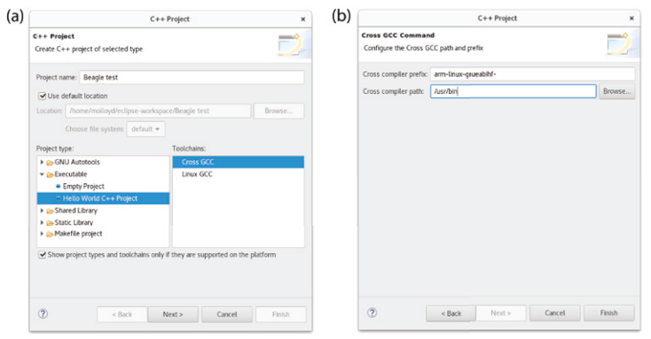
Configuring Eclipse for Cross-Compilation

Slide 194
Configuring Eclipse for Cross-Compilation
The Eclipse IDE is now configured for cross-compilation using the cross compilation toolchain that was set up at the beginning of this chapter.
You can choose Project ➪ Build All and then run on the desktop machine by clicking the green arrow or (Run ➪ Run).
In the following Figure this results in the message !!!Hello World!!! appearing in the Console window? No.
This appears on the desktop computer only if you have installed QEMU, as the executable contains ARM machine code, which is clear from the binary name “Beagle_Test - [arm/le]” that is highlighted on the top left of the Figure.

Slide 195
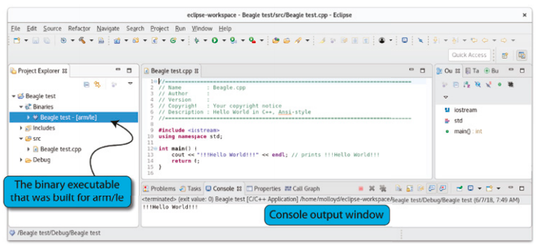
Configuring Eclipse for Cross-Compilation
The preceding steps provide a quick way of configuring the cross-compilation settings within Eclipse Oxygen.

Slide 196
Configuring Eclipse for Cross-Compilation
Older versions of Eclipse (e.g., Kepler) require you to configure the cross-compiler using the project settings.
That option is still available within Eclipse Oxygen—select the project that was just created and then go to Project ➪ Properties. (If the option is grayed out, it likely means that the project is not selected.)
Go to C/C++ Build ➪ Settings and on the Tool Settings tab you should see the Cross Settings as illustrated in the following Figure.
Effectively, these settings mean that the arm-linux-gnueabihf-g++ command is used to compile the project code.

Slide 197
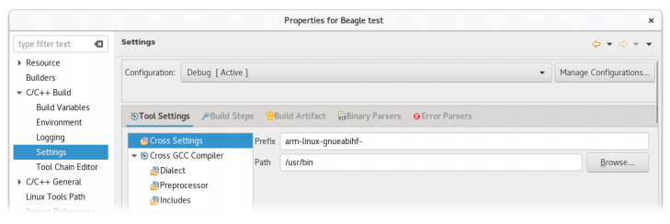
Configuring Eclipse for Cross-Compilation
It should not be necessary to set the C/C++ includes and library settings explicitly as they are included by default by gcc/g++.
However, it may be necessary at a later stage, particularly when using third-party libraries.

Slide 198
Configuring Eclipse for Cross-Compilation
To do this, go to Project ➪ Properties ➪ C/C++ General ➪ Paths and Symbols, and set the following:
Select Includes ➪ GNU C (Include directories) ➪ Add ➪ File System ➪ File System, enter /usr/include/arm-linux-gnueabihf/, and click OK.
Select Includes ➪ GNU C++ (Include directories) ➪ Add ➪ File System ➪File System, enter /usr/include/arm-linux-gnueabihf/c++/6/, and click OK.
Select Library Paths (not Libraries) ➪ Add ➪ File System ➪ File System and enter /usr/lib/arm-linux-gnueabihf/. Click OK to apply the configuration.

Slide 199
Configuring Eclipse for Cross-Compilation
Now you should be able to deploy the binary application (./Beagle_test) directly to your Beagle board, as it contains ARM machine code instructions. But at first we need to transfer its whole directory as
molloyd@desktop:~$ sftp debian@192.168.7.2
Sftp> put –r eclipse
Sftp> exit
molloyd@desktop:~$ ssh debian@192.168.7.2
debian@beaglebone:~$ cd eclipse
debian@beaglebone:~/eclipse$ cd Beagle_test
debian@beaglebone:~/eclipse/Beagle_test$ cd Debug
debian@beaglebone:~/eclipse/Beagle_test/Debug$ ./Beagle_test
Now you should be able to see the result: !!!!Hello world!!!
As you observed you can transfer the binary application to your board using sftp, but it would be better in the longer term if you had a direct link to your board from within Eclipse—for this you
can use the Remote System Explorer plug-in.

Slide 200
Session – March 25

Slide 201
Remote System Explorer
Attention: Some steps might not be able to show you from my system because I’m already done with the whole process!
The Remote System Explorer (RSE) plug-in enables you to establish a direct connection between your Eclipse environment and your Beagle board, over a network connection, by using the SSH server on your board. You can install the RSE within Eclipse using Help ➪ Install New Software.
From the “Work with” section and its drop-down choose 2020-09-http://download.eclipse.org/releases/2020-09. In the “type filter text” type “remote” and in the pop-up list of software click for “ Remote System Explorer User Actions” as well as “Remote System Explorer End-User Runtime”.
Click Next, follow the steps, and then restart Eclipse.
You should now have RSE functionality within Eclipse.
Go to Window ➪ Show View ➪ Other ➪ Remote Systems ➪ Remote Systems ➪ Open

Slide 202
Remote System Explorer
In the Remote Systems frame that appears, click the Define a Connection to Remote System icon, and in the New Connection dialog, select the following:
Choose Linux Type and then click Next.
For Host Name, enter your board’s IP address—e.g., 192.168.7.2.
For Connection Name, change it to Beaglebone and then click Next.
For [Files] Configuration, select ssh.files and then click Next.
For [Processes] Configuration, select processes.shell.linux and then click Next.
For [Shells] Configuration, select ssh.shells and then click Finish.
(Just in case:) To install the terminal, use Help ➪ Install New Software. From the “Work with” section and its drop-down choose 2020-09-http://download.eclipse.org/releases/2020-09 and then search for terminal. Install the TM Terminal View RSE add-in.

Slide 203
Remote System Explorer
To connect to the beaglebone board remotely: you can right click on Beaglebone entry on the Remote Systems tab and Connect. You should use Debian as the User ID and temppwd as the Password. Proceed with the connection
Also, to have an access to the terminal window (command prompt): from the arrow icon for Beaglebone entry on the Remote Systems tab find Ssh shells and then right click on it and Launch Shell.
Once you are connected to the board, you can go to the Project Explorer window and choose your project folder (in this example: Beagle_test) then Binaries sub-foldrer, then right-click the binary file you just built (in this example: Beagle test [arm/le]), and choose Copy.

Slide 204
Remote System Explorer
Then go to a directory in sftp Files of Beaglebone entry on the Remote Systems tab, such as My Home, then right-click it and choose Paste. The binary file is now on Beaglebone entry and can be executed from the Terminal window.
Just click on Remote Shell tab and in the terminal window change directory to the proper location of Beaglebone entry holding the binary file (if you have already chosen My Home, then obviously you don’t need to do change directory)
Now you need to convert the binary file to an executable one through typing the following command:
chmod ugo+x Beagle_test
Now you can run this code on your beaglebone board remotely as:
./Beagle_test
You should see the result (in this case: !!!Hello World!!!)

Slide 205
Integrating GitHub into Eclipse
There is a useful plug-in that can be installed into Eclipse that allows for full GitHub integration, enabling you to link to your own GitHub repositories or to get easy access to the example code and resources for this course.
To install it, select Help ➪ Install New Software, and From the “Work with” section and its drop-down choose 2020-09-http://download.eclipse.org/releases/2020-09. In the “type filter text” type “Git” .
Then, under the tree item Collaboration, choose “Eclipse GitHub integration with task focused interface.” Once this plug-in is installed, you can select Window ➪ Show View ➪ Other ➪ Git, and there are several options, such as Git Interactive Rebase, Git Reflog, Git Repositories, Git Staging, and Git Tree Compare.
If you choose Git Repositories, you then get the option Clone a Git repository and then GitHub, and you can search for Derek Molloy. You should find the repository derekmolloy/exploringBB.

Slide 206
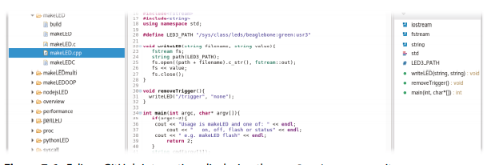
Integrating GitHub into Eclipse
If not, you can go back to the Clone URI option and add the repository directly using this: git://github.com/DerekMolloy/Exploringbb.git (you can clone all versions of the repository).
You will then have full access to the source code in this book directly from within the Eclipse IDE, as captured in the following Figure.
Because there are so many projects in this repository, the easiest way to use this code is to copy the files that you need into a new project.

Slide 207
Lab #7 Write a Program on Eclipse and Compile it on the ARM (BBB) by Using Cross Compilation
Method A: Goal) Write any short or simple C program such as a Hello World and compile the code and display the output of the code on your Beaglebone by Configuring Eclipse for Cross-Compilation (Deadline: April 7)
Step 1. In eclipse, first create a new C project.
Step 2. Once the C project is created, add source file in C project (such as a Hello World) by using extension .C
Step 3. While making the C project it is important to select cross GCC, as we will do cross compilation .
Tip: You can find the instruction in the lecture file (Configuring Eclipse for Cross-Compilation section)
Step 4. In C project, select properties and add prefix and path of the ARM

Slide 208
Lab #7 Write a Program on Eclipse and Compile it on the ARM (BBB) by Using Cross Compilation
Step 5. When the setting is done on Eclipse, transfer the project to the Beagle Bone
Tip: Sftp debian @ 192.168.7.2
Step 6. Login the Beagle Bone by using command : sudo ssh 192.168.7.2 –l debian and ensure the executable file is already created in BBB (How?). To check the results, run the code!
Method B: Goal) Write any short or simple C program such as a Hello World and compile the code and display the output of the code on your Beaglebone by Remote System Explore (Deadline: April 7)
Required steps: This time try to install the remote system explore within your Eclipse environment and run the same C project on your board through a direct connection between your Eclipse environment and your Beagle board, over a network connection, by using the SSH server on your board.
Tip: You can find the instruction in the lecture file (Remote System Explore section)

Slide 209
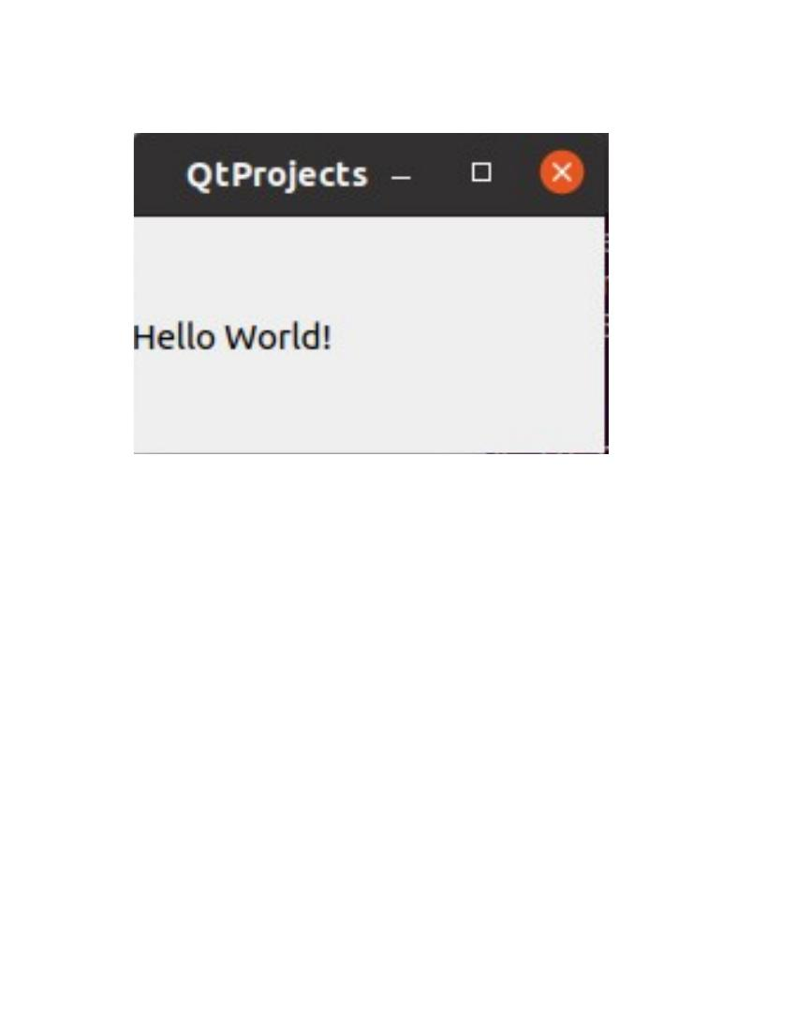
Qt for the Beaglebone
Qt (pronounced “cute”) is a powerful cross-platform development framework that uses standard C++. It provides libraries of C++ code for GUI application development and for database access, thread management, networking, and more.
Importantly, code developed under this framework can be executed under Windows, Linux, macOS, Android, and iOS, as well as on embedded platforms, such as the Beagle board.
Qt can be used under open-source or commercial terms, and it is supported by freely available development tools, such as qmake and Qt Creator.
The capability and flexibility of this framework make it an ideal candidate for GUI
applications that are to run directly on the Beagle board or on devices that control the
board.
Qt is described in greater detail in the next section, but it is useful to
get started using a simple “hello world” example, as illustrated in the
Figure, which can be compiled and executed on the Beagle board either directly or using VNC.

Slide 210
Installing Qt Development Tools
The first step is to install the Qt development tools
The last command in the following code snippet installs a full suite of tools (~20MB to 200MB of storage required depending on your current configuration).
The middle command identifies the constituent components of the suite.
molloyd@desktop:~$ sudo apt update
molloyd@desktop:~$ apt-cache search qt5
molloyd@desktop:~$ sudo apt install qt5-default
molloyd@desktop:~$ sudo apt install qtcreator
You can then test the version of the installation using the following:
molloyd@desktop:~$ qmake -version
QMake version 3.0
Using Qt version 5.7.1 in /usr/lib/x86_64-linux-gnu

Slide 211
The “Hello World” Qt Application
The following Listing is a concise Qt application that can be used as a test—it does not represent good Qt programming practice! It uses an object of the QLabel class, which is a subclass of the QWidget class, to display a message in the application.
A widget is the primary UI element that is used for creating GUIs with Qt.
The parent QWidget class provides the code required to render (draw) the subclass object on the screen display.
#include <QApplication>
#include <QLabel>
int main(int argc, char *argv[ ]){
QApplication app(argc, argv);
QLabel label("Hello World!");
label.resize(200, 100);
label.show();
return app.exec();
}

Slide 212
The “Hello World” Qt Application
The simpleQt.cpp file in this Listing is the only file required in a directory before the following steps take place. The qmake cross-platform makefile generator can then be used to create a default project. Let us first create a working directory that will later serve as a project directory for our Qt project. Then, create a simpleQt .cpp file in this directory through the nano editor as follows:
molloyd@desktop:~$ mkdir QtProject
molloyd@desktop:~$ cd QtProject
molloyd@desktop:~/QtProject$ nano simpleQt
In the blank file, copy this SimpleQt program whose sole purpose is to print a line of sentence on a window with the title “Hello World!”. After saving the file (cpp file), run the following command in order to create a Qt Project file. Running the ls command will display that the command has created a file by the name of QtProject.pro in the project directory. This project file is the basic skeleton file for Qt projects and it can be edited for complex purposes.
molloyd@desktop:~/ QtProject$ qmake –project
molloyd@desktop:~/QtProject$ ls
simpleQt.cpp QtProject.pro

Slide 213
The “Hello World” Qt Application
As we want to compile our project from the command line, we will need to add the following line to our .pro file.
QT += widgets
Open the simpleQt.pro file in the nano editor as follows. Add the above-mentioned line and Save the file by hitting Ctrl+X, and then by entering Y and hitting Enter.
molloyd@desktop:~/QtProject$ nano QtProject.pro
To ensure you did a correct job, use the following command:
molloyd@desktop:~/QtProject$ more QtProject.pro
######################################################################
# Automatically generated by qmake (3.0) Tue Aug 28 00:28:43 2018
######################################################################
TEMPLATE = app
TARGET = simpleQt
QT +=widgets
INCLUDEPATH += .
# Input
SOURCES += simpleQt.cpp

Slide 214
The “Hello World” Qt Application
This project .pro file describes the project settings ; if required, it can be edited manually to add additional dependencies. The qmake makefile generator can then be executed again, this time with no -project argument:
molloyd@desktop:~/QtProject$ qmake QtProject.pro
molloyd@desktop:~/QtProject$ ls
Makefile simpleQt.cpp QtProject.pro
This step results in a Makefile file being created in the current directory that allows the executable to be built using a call to make, which in turn uses g++ to build the final application.
molloyd@desktop:~/QtProject$ make
g++ -c -pipe -O2 -Wall -W -fPIC ... -o simpleQt.o simpleQt.cpp ...
The executable is now present in the directory and can be executed as follows, which results in the visual display shown earlier in the previous Figure:
molloyd@desktop:~/QtProject $ ls
Makefile simpleQt.cpp QtProject QtProject.o QtProject.pro
molloyd@desktop:~/QtProject$ ./simpleQt

Slide 215
Qt Primer
Qt is a full cross-platform development framework that is written in C/C++.
It is used in the preceding section for UI programming, but it also provides support for databases, threads, timers, networking, multimedia, XML processing, and more. Qt extends C++ by adding macros and introspection, code that examines the type and properties of an object at run time, which is not natively available in C++. It is important to note that all the code is still just plain C++!
Qt is built in modules, each of which can be added to your project by including the requisite header files in your C++ program and by identifying that the module is used in the project .pro file.
For example, to include the classes in the QtNetwork module, you add #include<QtNetwork> to your program code and link against the module by adding QT += network to the qmake .pro file.

Slide 216
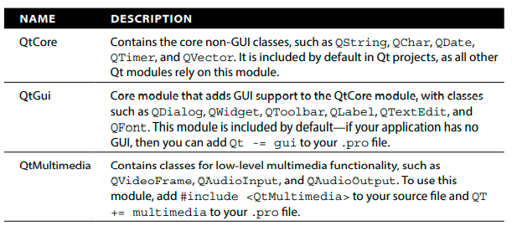
Qt Primer
The following Table provides a list of important Qt modules.

Slide 217
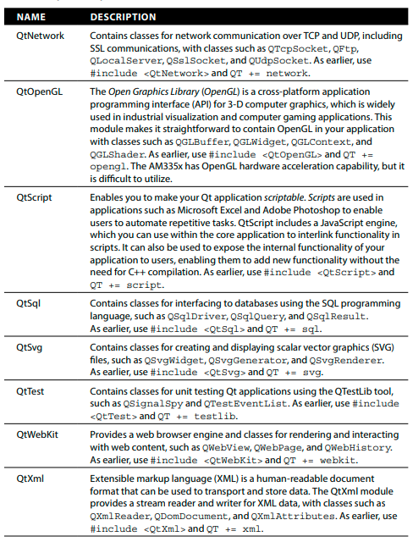
Qt Primer

Slide 218
The QObject Class
The QObject class is the base class of almost all the Qt classes and all the widgets.
This means most Qt classes share common functionality for handling memory management, properties, and event-driven programming.
Qt implements introspection by storing information about every class that is derived from QObject using a QMetaObject object within its Meta-Object System.
When you build projects using Qt you will see that new .cpp files appear in the build directory—these are created by the Meta-Object Compiler (moc).
The C++ compiler will then compile these files into a regular C/C++ objective file (.o), which is ultimately linked to create an executable application.

Slide 219
Signals and Slots
Similar to GTK+, Qt has an event-driven programming model that enables events and state changes to be interconnected with reactions using a mechanism termed signals and slots. For example, a Qt button widget can be configured so that when it is clicked, it generates a signal, which has been connected to a slot.
The slot, which is somewhat like a callback function, performs a user-defined function when it receives a signal.
Importantly, the signals and slots mechanism can be applied to non-GUI objects—it can be used for intercommunication between any object that is in any way derived from the QObject class.
Signals and slots provide a powerful mechanism that is possibly the most unique feature of the Qt framework.
A full-featured Qt application is developed shortly that makes extensive use of signals
and slots.

Slide 220
Signals and Slots
where source and destination are objects of classes that are derived from the QObject class. The signature is the function name and argument types (without the variable names).
The website www.qt.io provides an excellent detailed description of the behavior of signals and slots, but here are some further summary points on signals, slots, and connections that will get you started:
Signals can be connected to any number of slots.
Signals are defined in the signals section of the code (under a signals: label, which is usually in the class header file).
Signal “methods” must return void and may not have any implementation.
A signal can be explicitly emitted using the emit keyword.
Slots can be connected to any number of signals.
Slots are defined in the slots section of the code (under a slots: label that can be public, private, or protected).
Slots are regular methods with a full implementation.
Connections can be explicitly formed (as in the timer example shown earlier) or
automatically created when using the Qt graphical design tools in the next section.

Slide 221
Session – April 1-April 22

Slide 222
Qt Development Tools
The Qt framework also has associated development tools. As well as the qmake tool, there is a full-featured IDE called Qt Creator, which is similar in nature to Eclipse, except that it is specifically tailored for Qt development.
The IDE, which is illustrated in the following Figure, is available for Linux, Windows, and macOS, and its Qt Designer tool can even execute on the Beagle board directly. Qt Creator can be used to build native applications, or it can be used to cross-compile applications for the board by installing a cross-platform toolchain (similar to Eclipse).
To install and execute Qt Creator on the host machine (or on the beagle board e.g., via VNC), use the following steps, whereupon the IDE appears as in the Figure. Qt Creator needs approximately 400MB of installation space.
molloyd@desktop:~$ sudo apt install qtcreator
molloyd@desktop:~$ qtcreator &

Slide 223
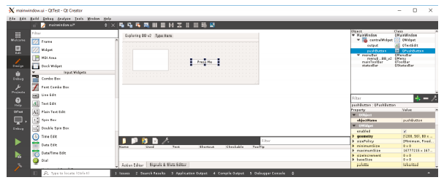
Qt Development Tools

Slide 224
Qt Development Tools
One of the key features that Qt Creator provides is its visual design editor, which enables you to interactively drag and drop widgets onto window designs, called forms. The interface enables the properties of the widgets to be configured easily, and it provides a straightforward way of enabling signals and associating slots against the UI components.
For example, to write code that executes when the Press Me button is clicked (refer to the Figure), you can simply right-click the button and choose “Go to slot,” which provides a dialog with a list of available signals (such as clicked(), pressed(), and released()).
Once a signal is chosen, the IDE will automatically enable the signal, provide a slot
code template, and associate the signal with the slot. The form UI’s properties are
stored in an XML file and associated with the project (e.g., mainwindow.ui).

Slide 225
A First Qt Creator Example
You can create a simple Qt GUI application on your host machine (or on a Beagle board) using Qt Creator by following these steps:
Create a new project of type Qt Widgets Application. Call it QtTest and create it in the /home/ directory.
Select the Desktop kit and choose the default class information. This results in a new project being created within Qt Creator, which appears as in the previous Figure when you double-click the mainwindow.ui form Forms.
In this window view, add a Push Button component and a Text Edit (QTextEdit) component, as illustrated in that Figure via drag and drop.
Right-click the text edit box and choose Change objectName. Change the object name to be output.
Retitle the button to Press Me and then right-click the button. Choose Go to Slot and then pick a signal such as clicked(). This creates a new function in the mainwindow.cpp file called on_pushButton_clicked(). See the following Figure.
You can then add a line of code to this method that sets the text of the output QTextEdit component, which is accessed via the ui main window.
void MainWindow::on_pushButton_clicked() {
ui->output->setText("Hello from Prof. Mike!");
}

Slide 226
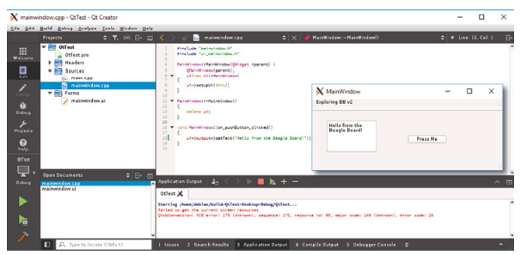
A First Qt Creator Example

Slide 227
A First Qt Creator Example
The application can be executed by clicking the Play button on the bottom-left side of
the Figure. The application window appears on the right side of the same figure.
When the Press Me button is clicked, then the text “Hello from Prof. Mike!”
appears in the output QTextEdit component.

Slide 228
Assignment #7: Qt-based Application
Part A: Create “Hello Beaglebone!” Qt application on a Beagle board through the steps mentioned during the lecture (slides 210-214) (Deadline: April 7)
Hint: You need to ensure the board is connected to the Internet!
Part B: Create “Hello from the Beaglebone!” Qt GUI application on a Beagle board through the steps mentioned during the lecture (slides 221-225) (Deadline: April 7)
Hint: You need to ensure the board is connected to the Internet!

Slide 229
Assignment #8: Capturing Images and Video (Have you already prepared your camera?)
Step 1: Study the materials in the last module (Slides 231 – 253)
Step 2: Prepare a ppt file in student version from the materials so that it should show your understanding from the module without missing any points!
Deadline: April 14

Slide 230
Lab #8: Capturing Images and Video
Step 1: In order to enable your Beagle board to capture images and video, set up all the required adjustments on your board through the terminal commands mentioned in Assignment #8
Step 2: Compile and run all the example code mentioned in Assignment #8 on your Beagle board!
Step 3: Record your results in a word document and a provide a link to watch the video from your result!
Deadline: April 21

Slide 231
Capturing Images and Video
In this section, the Beagle board is used as a platform for capturing image and video data from USB webcams and saving the data on the board’s file system.
This is useful for Beagle board applications such as robotics, home security, home automation, and aeronautics, when networked image streaming is not an available option—for example, if the application is untethered and distant from a wireless network.
With suitable peripherals, the board can be used to capture high-quality video streams, which can be viewed asynchronously.
The durations of the video streams are limited only by the available storage on the board. (Previously we described an approach for mounting a high-capacity microSD card or USB memory device on the file system.)
Alternatively, the video can be streamed to the network, which is discussed in the
next section of this chapter.

Slide 232
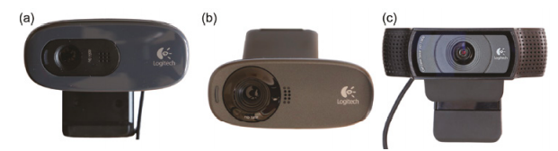
USB Webcams
The main focus in this section is USB webcams, as they are widely available and can be reused as a general-purpose desktop peripheral.
The Logitech HD C270 ($26), HD C310 ($30), and HD Pro C920 ($70), shown in the following Figure, are chosen, as they are commonly available HD cameras that are known to function under Linux.
In fact, for the following tests the three cameras are connected simultaneously to the Beagle board using the USB hub.

Slide 233
USB Webcams
It is not a powered USB hub, but the board is connected to a 5V 2A supply in this case.
When the three USB cameras are connected to the board at the same time using a USB hub, the “list USB devices” utility provides the following output
debian@ebb:~$ lsusb
Bus 001 Device 002: ID 1a40:0201 Terminus Technology Inc. FE 2.1 7-port Hub
Bus 001 Device 001: ID 1d6b:0002 Linux Foundation 2.0 root hub
Bus 002 Device 001: ID 1d6b:0002 Linux Foundation 2.0 root hub
Bus 001 Device 003: ID 046d:082d Logitech, Inc. HD Pro Webcam C920
Bus 001 Device 004: ID 046d:0825 Logitech, Inc. Webcam C270
Bus 001 Device 005: ID 046d:081b Logitech, Inc. Webcam C310
The output lists the device IDs for the cameras, two USB sound adapters, and a Bluetooth adapter.
The fact that “Logitech” is listed against the device IDs indicates that some level of Linux support is already present on the board for these devices.

Slide 234
USB Webcams
If this is not the case, then you will have to source proprietary Linux drivers from the webcam manufacturer.
Typically, such drivers would be built and deployed on the board before the webcam could be used.
Full information about the modes that are available on the USB cameras can be displayed using the following:
debian@ebb:~$ lsusb -v | less
This command results in detailed and verbose output.
In addition, the loadable kernel modules (LKMs) that are currently loaded against these peripherals can be listed using the following command:

Slide 235
USB Webcams
debian@ebb:~$ lsmod
Module Size Used by
snd_usb_audio 184320 0
uvcvideo 90112 0
snd_hwdep 20480 1 snd_usb_audio
videobuf2_vmalloc 16384 1 uvcvideo
videobuf2_memops 16384 1 videobuf2_vmalloc
snd_rawmidi 32768 1 snd_usbmidi_lib
videobuf2_v4l2 24576 1 uvcvideo
videobuf2_core 45056 2 uvcvideo,videobuf2_v4l2 ...
The uvcvideo LKM supports UVC (USB video class) compliant devices, such as the webcam that is attached.
The videobuf2_vmalloc LKM is the memory allocator for the Video4Linux video buffer.
If everything is working as expected, there should be new video and audio devices available, which can be listed using the following:
debian@ebb:~$ ls /dev/{vid,aud}*
/dev/audio /dev/audio2 /dev/video0 /dev/audio1 /dev/video2
/dev/audio3 /dev/video1

Slide 236
USB Webcams
The device /dev/audio is mapped to the HDMI audio device, which will appear only if the HDMI virtual cape is enabled.
The other audio devices are mapped to USB audio adapters and USB webcams.

Slide 237
Video4Linux2 (V4L2)
Video4Linux2 (V4L2) is a video capture driver framework that is tightly integrated with the Linux kernel and is supported by the uvcvideo LKM.
It provides drivers for video devices, such as webcams, PCI video capture cards, and TV (DVB-T/S) tuner cards/peripherals. V4L2 primarily supports video (and audio) devices through the following types of interfaces:
Video capture interface: Used to capture video from capture devices, such as webcams, TV tuners, or video capture devices
Video output interface: For video output devices, e.g., video transmission devices or video streaming devices
Video overlay interface: Enables the direct display of the video data without requiring the data to be processed by the CPU
Video blanking interval (VBI) interface: Provides access to legacy data that is transmitted during the VBI of an analog video signal (e.g., teletext)
Radio interface: Provides access to AM/FM tuner audio streams

Slide 238
Video4Linux2 (V4L2)
V4L2 provides support for many types of devices, and simply put, it is complex!
In addition to supporting video input/output, the V4L2 API also has stubs for codec and video effect devices, which enable manipulation of the video stream data.
The focus in this section is on the capture of video data from webcam devices using V4L2 by performing the following steps (not necessarily in this order):
Opening the V4L2 device
Changing the device properties (e.g., camera brightness)
Agreeing on a data format and input/output method
Performing the transfer of data
Closing the V4L2 device
The main source of documentation on V4L2 is available from www.kernel.org at
tiny.cc/beagle1402, and the V4L2 API specification is available at tiny.cc/beagle1403.

Slide 239
Video4Linux2 (V4L2)
The first step is to install the V4L2 development libraries, abstraction layer, utilities, and a simple webcam application for V4L2-compatible devices.
Always update the package lists to get information about the newest packages and their
dependencies, before installing a system library:
debian@ebb:~$ sudo apt-get update
debian@ebb:~$ apt-cache search v4l2
libv4l-dev - Collection of video4linux support libraries..
Then, install the packages that are required for this section:
debian@ebb:~$ sudo apt-get install fswebcam gpicview libav-tools libv4l-dev
The fswebcam application can then be used to test that the attached web camera is working correctly.

Slide 240
Video4Linux2 (V4L2)
It is a surprisingly powerful and easy-to-use application that is best used by writing a configuration file, as shown in the following Listing, which contains settings for choosing the device, capture resolution, output file type, and the addition of a title banner.
device /dev/video0
input 0
resolution 1280x720
bottom-banner
font /usr/share/fonts/truetype/ttf-dejavu/DejaVuSans.ttf
title "Exploring BeagleBone v2"
timestamp "%H:%M:%S %d/%m/%Y (%Z)"
png 0
save exploringBB.png
It can even be used on a continuous loop by adding a loop entry that specifies the time in seconds between frame captures.

Slide 241
Video4Linux2 (V4L2)
The fswebcam application can be configured with these settings by passing it the configuration filename on execution:
.../chp14/fswebcam$ ls
fswebcam.conf
.../chp14/fswebcam$ sudo fswebcam -c fswebcam.conf
--- Opening /dev/video0... Trying source module v4l2...
/dev/video0 opened. --- Capturing frame... ...
The image can then be viewed using gpicview, which requires that you have attached a display to the Beagle board, such as a VNC connection:
.../chp14/fswebcam$ gpicview exploringBB.png
This will result in output like that in the following Figure (a).
The image data has been modified to include a formatted bottom text banner, which contains a title and the date and time of image capture.

Slide 242
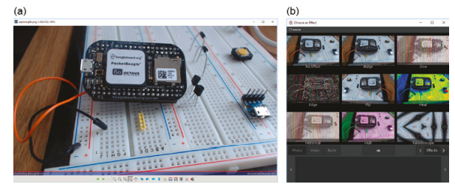
Video4Linux2 (V4L2)
Interestingly, the fswebcam application could be executed on a loop and combined with the Apache web server to create a simple web camera, which uses a web page that links to the captured image file present on the Beagle board file system.

Slide 243
Video4Linux2 (V4L2)
V4L2 provides a set of user-space utilities that can be used for obtaining information about connected V4L2-compatible devices.
It is also possible to use the user-space utilities to change camera settings; however, it is possible that executed applications will be programmed to override such changes.
The most important role of these tools is to verify that connected V4L2 devices are functioning correctly.
You can list the available V4L2 devices using the following:
debian@ebb:~$ v4l2-ctl --list-devices
HD Pro Webcam C920 (usb-musb-hdrc.1-1): /dev/video0
The devices appear in the order in which they are attached to the USB hub.
You can get information about a particular device by listing its modes (where-d 0
refers to the HD Pro C920 in this instance).

Slide 244
Video4Linux2 (V4L2)
V4L2 provides a set of user-space utilities that can be used for obtaining information about connected V4L2-compatible devices.
It is also possible to use the user-space utilities to change camera settings; however, it is possible that executed applications will be programmed to override such changes.
The most important role of these tools is to verify that connected V4L2 devices are functioning correctly.
You can list the available V4L2 devices using the following:
debian@ebb:~$ v4l2-ctl --list-devices
HD Pro Webcam C920 (usb-musb-hdrc.1-1): /dev/video0
The devices appear in the order in which they are attached to the USB hub.
You can get information about a particular device by listing its modes (where-d 0
refers to the HD Pro C920 in this instance).

Slide 245
Video4Linux2 (V4L2)
debian@ebb:~$ v4l2-ctl --all -d 0
Driver Info (not using libv4l2):
Driver name : uvcvideo
Card type : HD Pro Webcam C920
Bus info : usb-musb-hdrc.1-1
Driver version: 4.14.54
Capabilities : 0x84200001 Video Capture Streaming
Certain controls can be used to configure a camera, which can be accessed using the --list-ctrls option, as follows:
debian@ebb:~$ v4l2-ctl --list-ctrls -d 0
brightness (int) : min=0 max=255 step=1 default=128 value=128
contrast (int) : min=0 max=255 step=1 default=128 value=128
saturation (int) : min=0 max=255 step=1 default=128 value=128
white_balance_temperature_auto (bool) : default=1 value=1
gain (int) : min=0 max=255 step=1 default=0 value=255 ...

Slide 246
Video4Linux2 (V4L2)
For the C920, other controls include white balance, color temperature, sharpness, backlight compensation, exposure (auto or absolute), focus, zoom, and support for pan/tilt. For example, to change the brightness on device 0 to 100 (currently 128 as shown in the preceding snippet), you can use the following:
debian@ebb:~$ v4l2-ctl --set-ctrl=brightness=100 -d 0
debian@ebb:~$ v4l2-ctl --list-ctrls -d 0 | grep brightness
brightness (int) : min=0 max=255 step=1 default=128 value=100
You can also list the modes of the cameras. In this case, there are three different video capture pixel formats, with fourcc color space video codes: YUYV (a common broadcast format with one luminance and two chrominance channels), H264 (a common modern interframe video compression format), and MJPG (a common, but older, intraframe-only motion JPEG video compression format).
The listing is obtained using the following:
debian@ebb:~$ v4l2-ctl --list-formats -d 0
ioctl: VIDIOC_ENUM_FMT
Index : 0 Type : Video Capture
Pixel Format: 'YUYV' Name : YUYV 4:2:2
Index : 1 Type : Video Capture
Pixel Format: 'H264' (compressed) Name : H.264
Index : 2 Type : Video Capture
Pixel Format: 'MJPG' (compressed) Name : Motion-JPEG

Slide 247
Video4Linux2 (V4L2)
The C270 and C310 cameras do not have H.264 mode, but they both have YUYV and MJPG compressed pixel formats at indices 0 and 1, respectively.
It is possible to explicitly set the resolution and pixel format of a camera as follows:
~$ v4l2-ctl --set-fmt-video=width=1920,height=1080,pixelformat=1 -d 0
~$ v4l2-ctl --all -d 0
Driver Info (not using libv4l2):
Driver name : uvcvideo
Card type : HD Pro Webcam C920
Bus info : usb-musb-hdrc.1-1
Driver version: 4.14.54 ...
Capabilities : 0x84000001 Video Capture Streaming
Format Video Capture:
Width/Height : 1920/1080 Pixel Format : 'H264'
Field : None Bytes per Line : 3840
Size Image : 4147200 Colorspace : SRGB
Crop Capability Video Capture:
Bounds : Left 0, Top 0, Width 1920, Height 1080
Default : Left 0, Top 0, Width 1920, Height 1080
Pixel Aspect : 1/1
Video input : 0 (Camera 1: ok)
Streaming Parameters Video Capture:
Capabilities : timeperframe Frames per second: 30.000 (30/1)
Read buffers : 0 Priority: 2

Slide 248
Video4Linux2 (V4L2)
This output provides useful state information, such as the resolution, video frame image size, frame rate, and so on.
As with other devices in Linux (e.g., SPI), it is possible to send data to and receive data from a video device by opening its /dev/videoX file system entry by using a call to file open(). Unfortunately, such an approach would not provide the level of control or performance that is required for video devices.
Instead, low-level input/output control (ioctl()) calls are required to configure the settings of the device, and memory map (mmap()) calls are used to perform image frame memory copy, rather than using a byte-by-byte serial transfer.
The Git repository contains programs in the /chp14/v4l2/ directory that use V4L2 and its low-level ioctl() calls to perform video frame capture and video capture tasks.

Slide 249
Video4Linux2 (V4L2)
grabber.c: Grabs raw image frame data from a webcam into memory using libv4l2. The images can be written to the file system.
capture.c: Grabs raw video data to a stream or file. It does this quickly enough to be used for real-time video capture.
These code examples are almost entirely based on the samples that are provided by the V4L2 project team.
The code is too long to display here, but you can view it in the Molly Book Git repository.
To build and execute the code examples, use the following steps:

Slide 250
Video4Linux2 (V4L2)
~/exploringbb/chp14/v4l2$ sudo apt install libv4l-dev
.../chp14/v4l2$ ls *.c
capture.c grabber.c
.../chp14/v4l2$ gcc -O2 -Wall `pkg-config --cflags --libs libv4l2` →
grabber.c -o grabber
.../chp14/v4l2$ gcc -O2 -Wall `pkg-config --cflags --libs libv4l2` →
capture.c -o capture
.../chp14/v4l2$ ./grabber
.../chp14/v4l2$ ls *.ppm
grabber000.ppm grabber005.ppm grabber010.ppm grabber015.ppm ...
.../chp14/v4l2$ gpicview grabber000.ppm
The .ppm file format describes an uncompressed color image format, which gpicview will display. You can use the “forward” button on gpicview to step through the 20 image frames.
To capture data using the capture.c program, use a selection of the following options:

Slide 251
Video4Linux2 (V4L2)
.../chp14/v4l2$ ./capture -h
Usage: ./capture [options]
Version 1.3 Options:
-d | --device name Video device name [/dev/video0] ...
-f | --format Force format to 640x480 YUYV
-F | --formatH264 Force format to 1920x1080 H264
-c | --count Number of frames to grab [100] - use 0 for infinite
Example usage: capture -F -o -c 300 > output.raw
Captures 300 frames of H264 at 1920x1080. Use raw2mpg4 script to convert to mpg4
If you have the C920 camera, you can capture 100 frames of H.264 data using the first of the following commands.
A second command then converts the .raw file to a .mp4 file format, which can be played on a desktop machine.
.../chp14/v4l2$ ./capture -d /dev/video0 -F -o -c 100 > output.raw
Force Format 2
......................................................................
.../chp14/v4l2$ avconv -f h264 -i output.raw -vcodec copy output.mp4
.../chp14/v4l2$ ls -l output*
-rw-r--r-- 1 debian debian 1355695 Sep 3 22:23 output.mp4
-rw-r--r-- 1 debian debian 1353801 Sep 3 22:23 output.raw

Slide 252
Video4Linux2 (V4L2)
The file sizes are almost identical because the video data is actually captured in a raw H.264 format. The conversion is performed using the avconv (Libav) utility, which is a fork of the FFmpeg project that is well supported by the Debian Linux distribution.
The -vcodec copy option enables the video to be copied without transcoding the video data format. The capture.c program can also be used with cameras such as the C270 and C310, which do not have hardware H.264 functionality; however, the capabilities are more limited.
...$ v4l2-ctl --set-fmt-video=width=1280,height=720,pixelformat=1 -d 1
...$ v4l2-ctl --all -d 1
Format Video Capture: Width/Height:1280/720 Pixel Format:'MJPG'
.../chp14/v4l2$ ./capture -d /dev/video1 -o -c 100 > output.raw
Force Format 0 ......................................................
.../chp14/v4l2$ ls -l output.raw
-rw-r--r-- 1 debian debian 4476448 Sep 3 01:58 output.raw
.../chp14/v4l2$ avconv -f mjpeg -i output.raw output.mp4
.../chp14/v4l2$ ls -l output.mp4
-rw-r--r-- 1 debian debian 1456040 Sep 3 02:06 output.mp4
True video conversion using avconv can take quite some time on the Beagle board!
In this example, you can see that the H.264 video file requires significantly less
space than the MJPEG file, as it is a more efficient interframe videoencoding format.

Slide 253
Video4Linux2 (V4L2)
The last point: A common problem arises when using the capture.c program. The camera returns a “select timeout” error. If this arises, then you need to change the timeout properties of the uvcvideo LKM as follows:
debian@ebb:~$ sudo rmmod uvcvideo
debian@ebb:~$ sudo modprobe uvcvideo nodrop=1 timeout=5000
debian@ebb:~$ lsmod | grep uvcvideo
uvcvideo 90112 0
videobuf2_vmalloc 16384 1 uvcvideo
videobuf2_v4l2 24576 1 uvcvideo
videobuf2_core 45056 2 uvcvideo,videobuf2_v4l2

Slide 254
Reference
Exploring Beagle Bone: Tools and Techniques for Building with
Embedded Linux
by Derek Molloy
udev - Linux dynamic device management
https://wiki.debian.org/udev
Embedded Linux Systems with the Yocto Project
by Rudolf J. Streif

